Slide 1

Design and evaluation of a Deep Learning approach to quantify immune cell infiltrates in volumetric autofluorescence image data
Dobrovolskii Sergei
Master Thesis
Superviser: Dr. Sebastian Schürmann
Notes:
Good morning to everybody! My name is Sergei Dobrovolskii, and I am studying a master's degree in advanced optical technologies at Friedrich Alexander Universität. Today, I am glad to present to you my Master Thesis presentation. The topic is Design and evaluation of a Deep Learning approach to quantify immune cell infiltrates in volumetric autofluorescence image data.

Slide 2
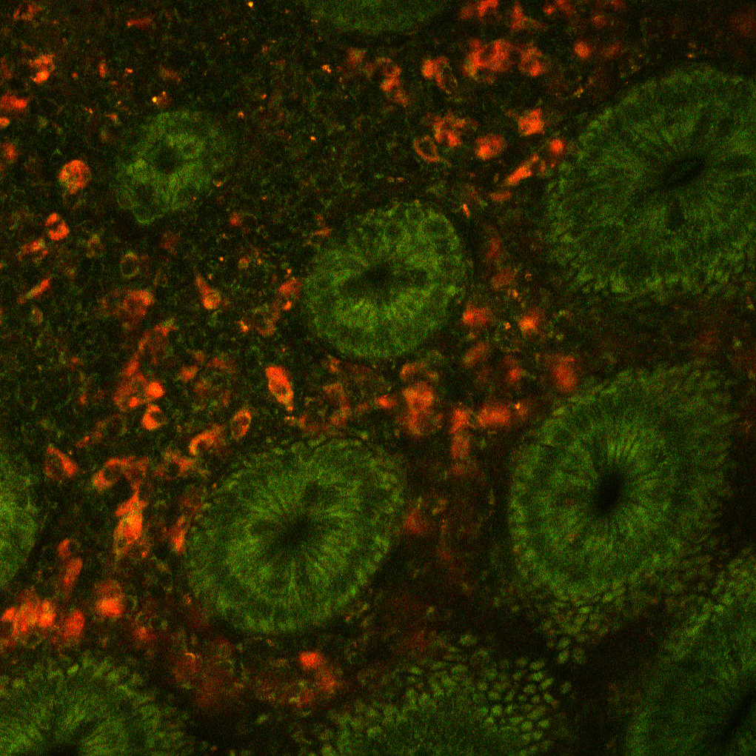
Outline
01
Motivation
02
Cell Simulator
03
Neural Network
04
Quantification performance
05
Conclusion
FAD (red), NADH (green) MPM image of colon tissue
Notes:
At the FAU MBT laboratory, we examine immune cell infiltrations in colon tissue. For research purposes, label-free Multiphoton stacks were acquired. Stacks are a good source of data, but cells must be counted and classified for statistical analysis. This work aims to provide an answer to this question. We will begin with a chapter on motivation before moving on to the developed software "Cell simulator" and trained neural network that counts cells. Finally, we will discuss the outcomes and draw a conclusion.

Slide 3
Motivation Quantification of immune cells in stacks

Slide 4
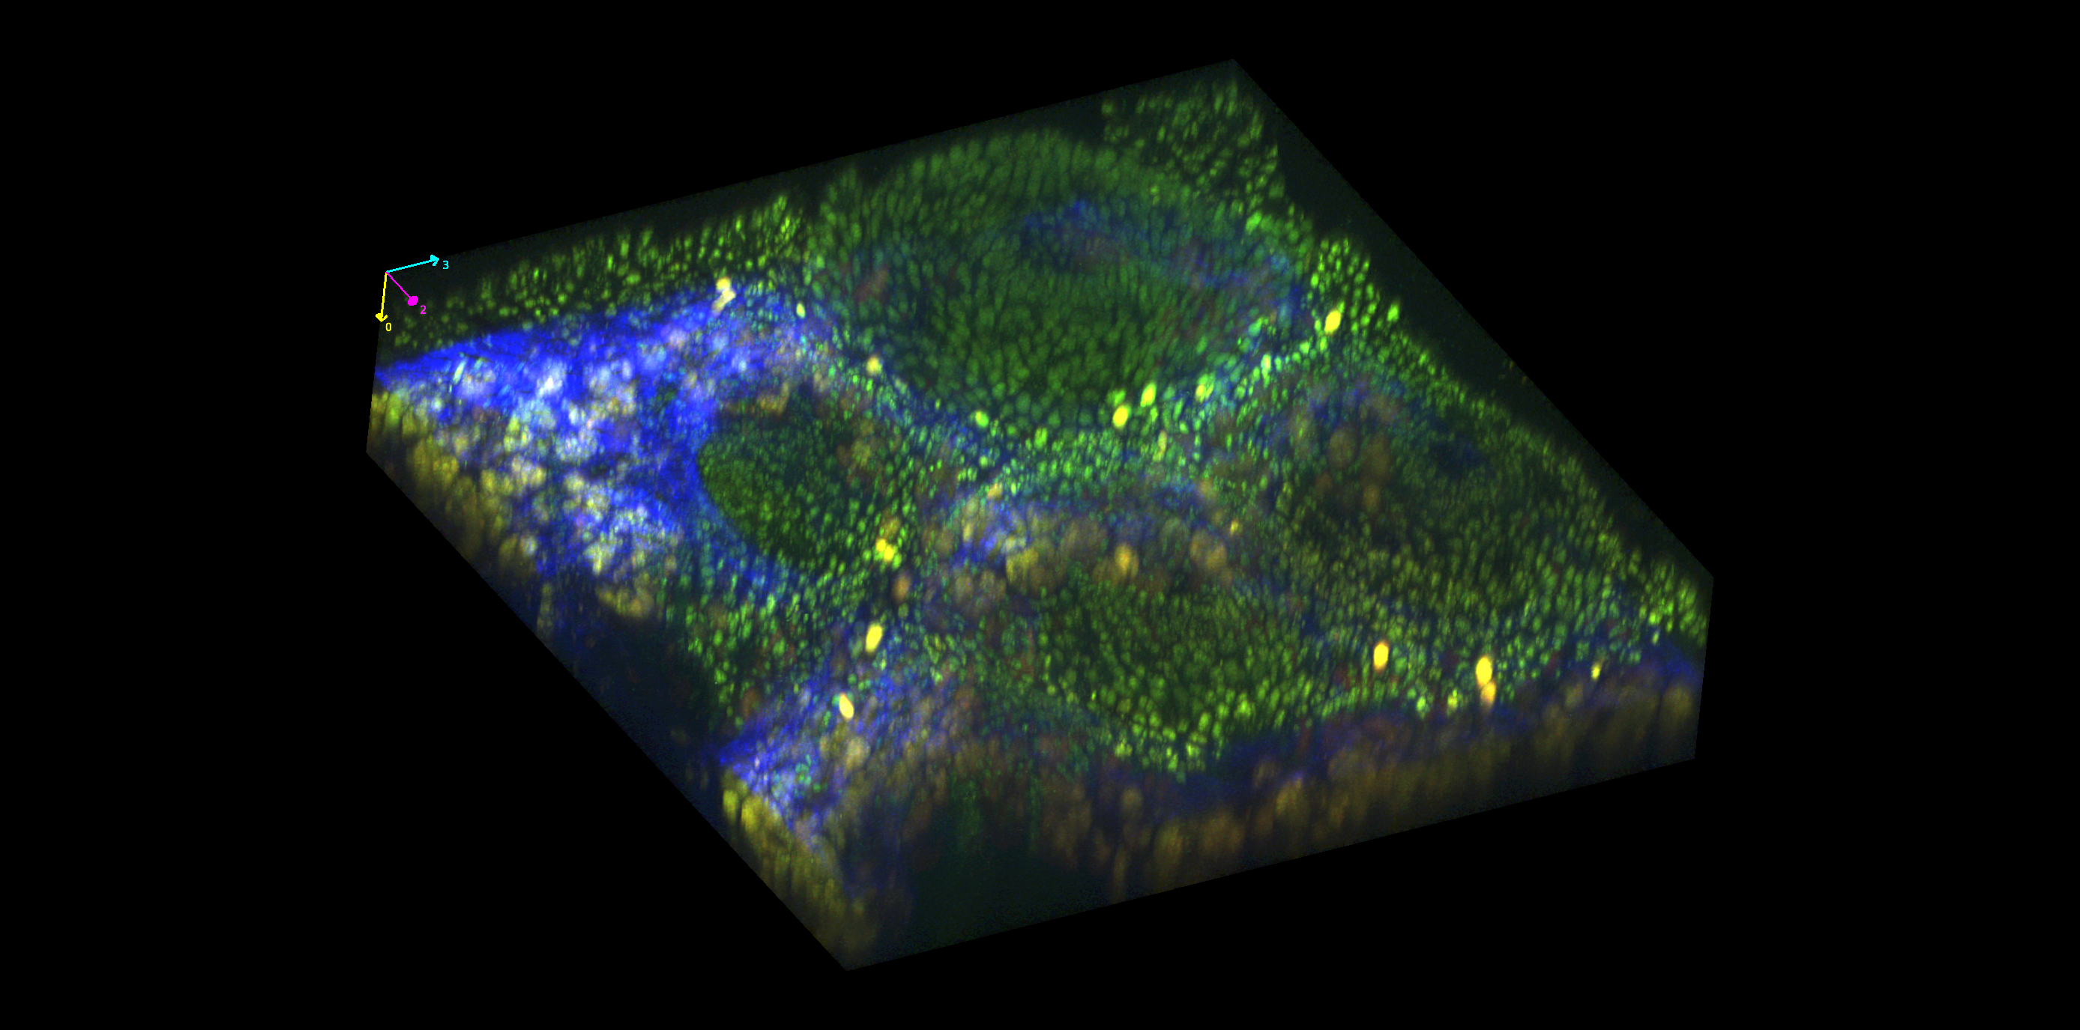
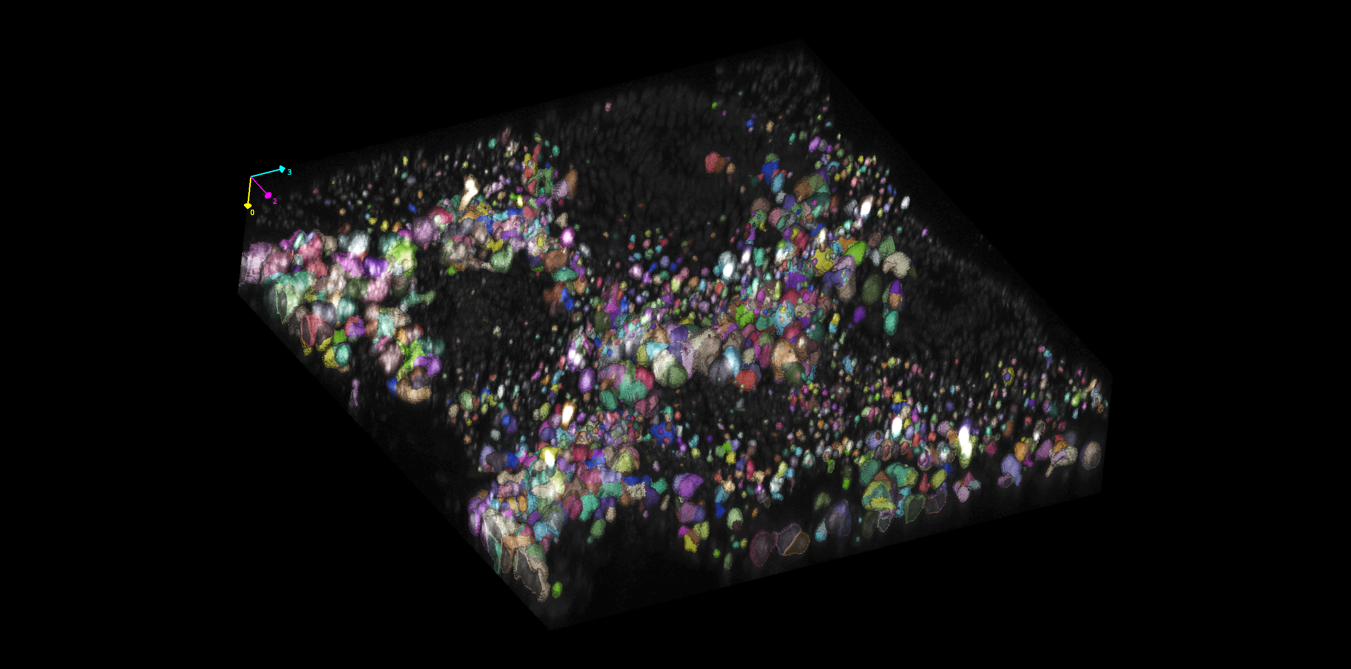
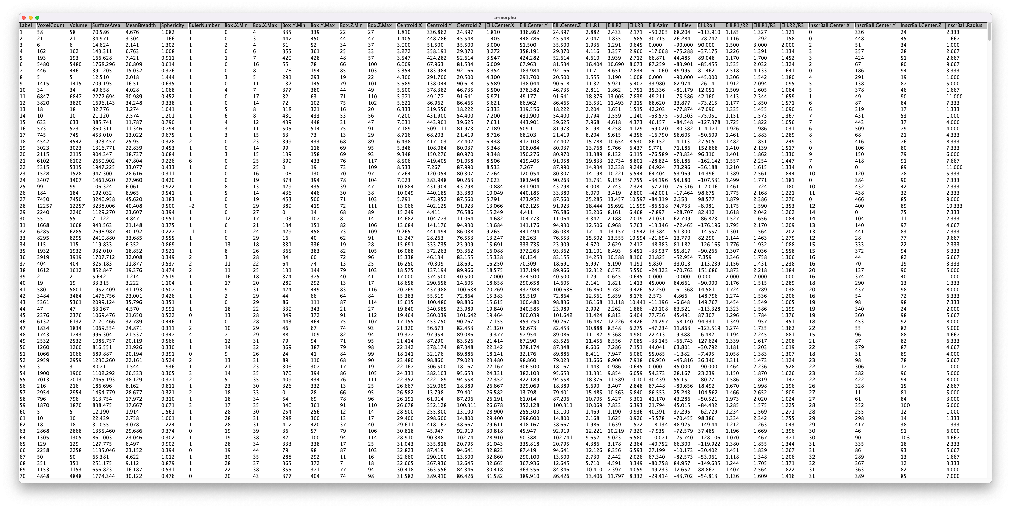
Analysis sequence
Common analysis sequence for cell count and classification
1.
2.
3.
3D stack of human colon tissue, acquired with MPM
Cell segmentation and labeling
Statistical analysis
Notes:
Any analysis begins with experimental data
- In our case it is a volumetric image named stack. It contains three autofluorescence channels: red for FAD (Flavin adenine dinucleotide), green for NADH (nicotinamide adenine dinucleotide (NAD) + hydrogen (H), and blue for collagen. Then, you select the channel you wish to work with, which in our instance is the FAD channel because it properly represents immune cells.
- And then you employ an algorithm to process this data and obtain cell masks for each instance of a cell.
- After that you work with statistical analysis. Let's find out which algorithm should be used for cell segmentation?

Slide 5
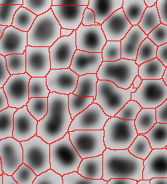
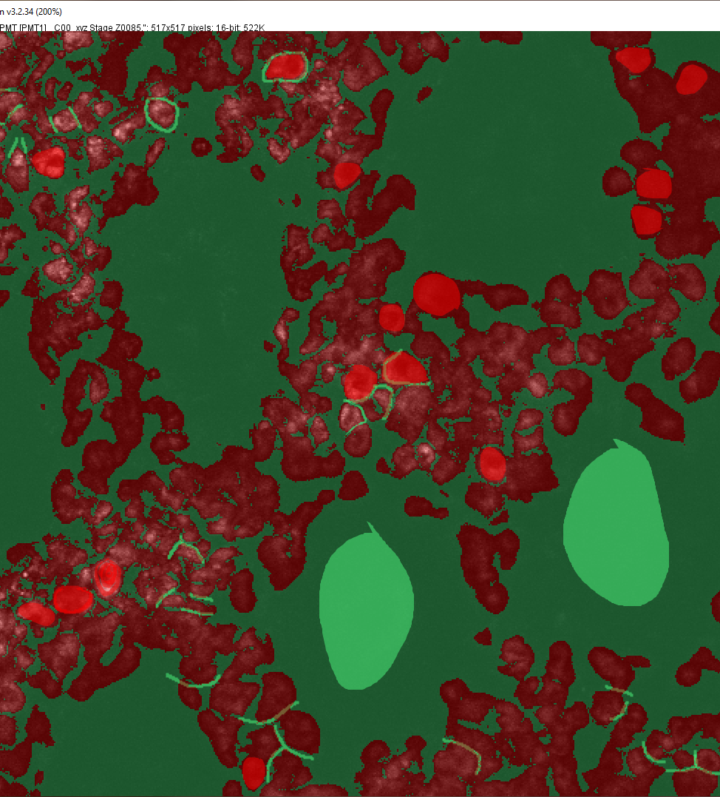
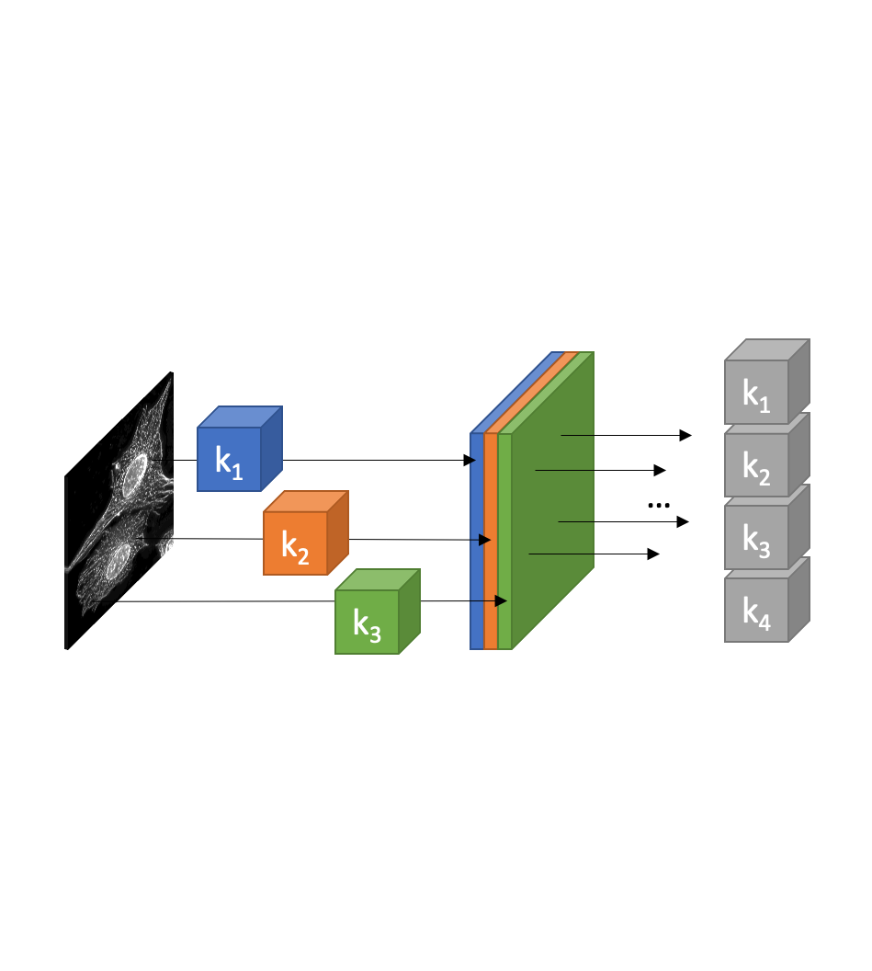
Image analysis
Three main image analysis approaches
Classical algorithms:
Threshold, Watershed, region growing, filtering…
Classical Machine Learning algorithms: Random Forest: Ilastik, Weka ImageJ plugin
Modern Machine Learning (Deep Learning): U-net, LinkNet, Mask-RCNN, YOLO
Notes:
In computer vision, there are three fundamental types of algorithms:
- classical algorithms, like thresholding, watershed, region growing
- classical machine learning, like Ilastik and Weka segmentation plugin for imageJ
- and modern machine learning also known as (deep learning).

Slide 6
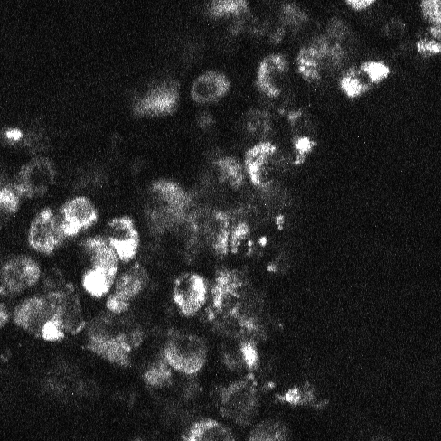
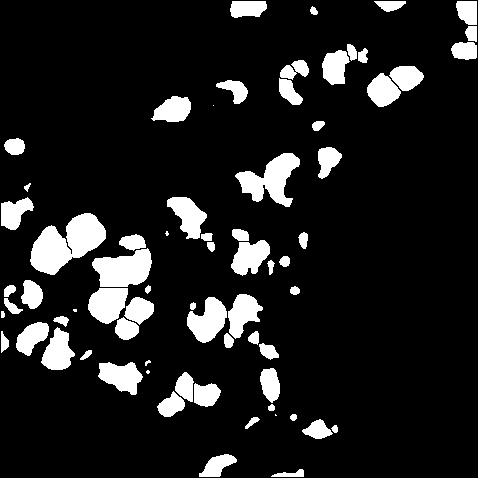
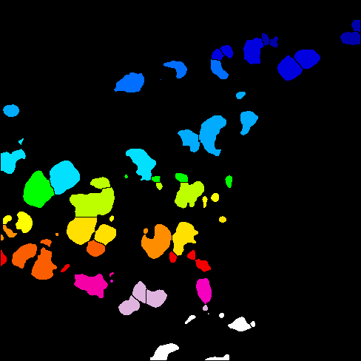

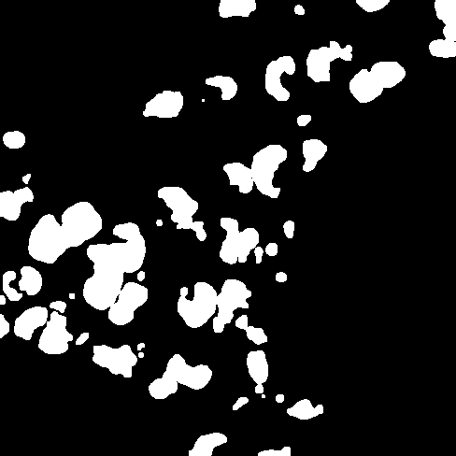



Image analysis
Common sequence to analyze and classify cells with classical algorithms
3.Fill holes
4.Erode
5.Dilate
6.Watershed
7.Label
1.Blur
2.Threshold
0.Raw
Common features for cell classification:
Size
Volume
Perimeter
Intensity
Sphericity
Shape
Eccentricity
Texture
Notes:
Common sequences for classical algorithms include - blurring
- thresholding
- binary operations like filling holes
- erosion
- dilation
- and watershed. - - The features of each segmented cell are then extracted for cell classification. -Size, -volume, -perimeter, -intensity, -sphericity, -shape, -eccentricity, -texture, etc. Already, the outcome does not appear promising.

Slide 7
Image analysis
Why classical algorithms are not compatible with experimental data
Why does it not work?
Images are volumetric
Illumination inhomogeneties
Signal to noise (autofluorescence)
Acquisition artifacts (PSF, scattering, attenuation)
High cell density
High image variation
FAD fluorescence
Real image of immune cells in FAD channel
Notes:
Why classical algorithms do not work with our data? -There are following reasons:
1. Images are volumetric and not planar. Most of classical approaches were developed for 2d data, and don't scale up well for 3d.
2. Illumination inhomogeneties
3. Signal to noise ratio is adding another challenge
4. Acquisition artifacts (PSF, Scattering, attenuation)
5. High density of cells in image. All cells are tightly localized between crypts
6. High image variation adds complexity to classical algorithms and forces researches to adjust methodology for different images
7. FAD fluorescence. Instead of luminous blobs, cells appear as rings or thoroids.
All of these factors make cell detection with conventional methods extremely difficult. That's why we will consider machine learning approaches instead.

Slide 8
Machine Learning in image analysis
What is Machine Learning?
Question
Algorithm
Answer
Data
ML algorithm
Output
Exploitation phase
Data
ML algorithm
Output
Training phase
Training dataset
Notes:
What is the definition of machine learning? Machine learning is an algorithm that produces an answer to a specific question. But how does this algorithm know what answer to provide in response to a question?
- The algorithm is taught by example. This is accomplished during the so-called training phase, during which the machine learning algorithm is trained using samples of answers to a given question.
- Pairs of data and corresponding correct output is called a training dataset, which is essential in machine learning.

Slide 9
Machine Learning in image analysis
Classical Machine Learning vs. Deep Learning
Classical Machine Learning approaches
Acquisition
Preprocessing
Feature Extraction
Classification
Class
ML algorithm
Deep Learning (DL) approaches
Acquisition
Preprocessing
Feature Extraction
Classification
Class
DL algorithm
Notes:
Now what is the difference between machine learing and deep learning? To answer this question let's consider an abstract sequence of image classification. First you start with acquistion, record a stack by camera or photodetector, then you preprocess this data, adjust contrast, equalize histogram. After that you extract features, like edges, textures, gradients and only then use these featrues for machine learning algorithm to process. - Deep learning eliminates the need to preprocess data and extract features; these stages, are performed entirely by an algorithm. It means that no prior knowledge of feature extraction and preprocessing is required, as the algorithm will perform it automatically.

Slide 10
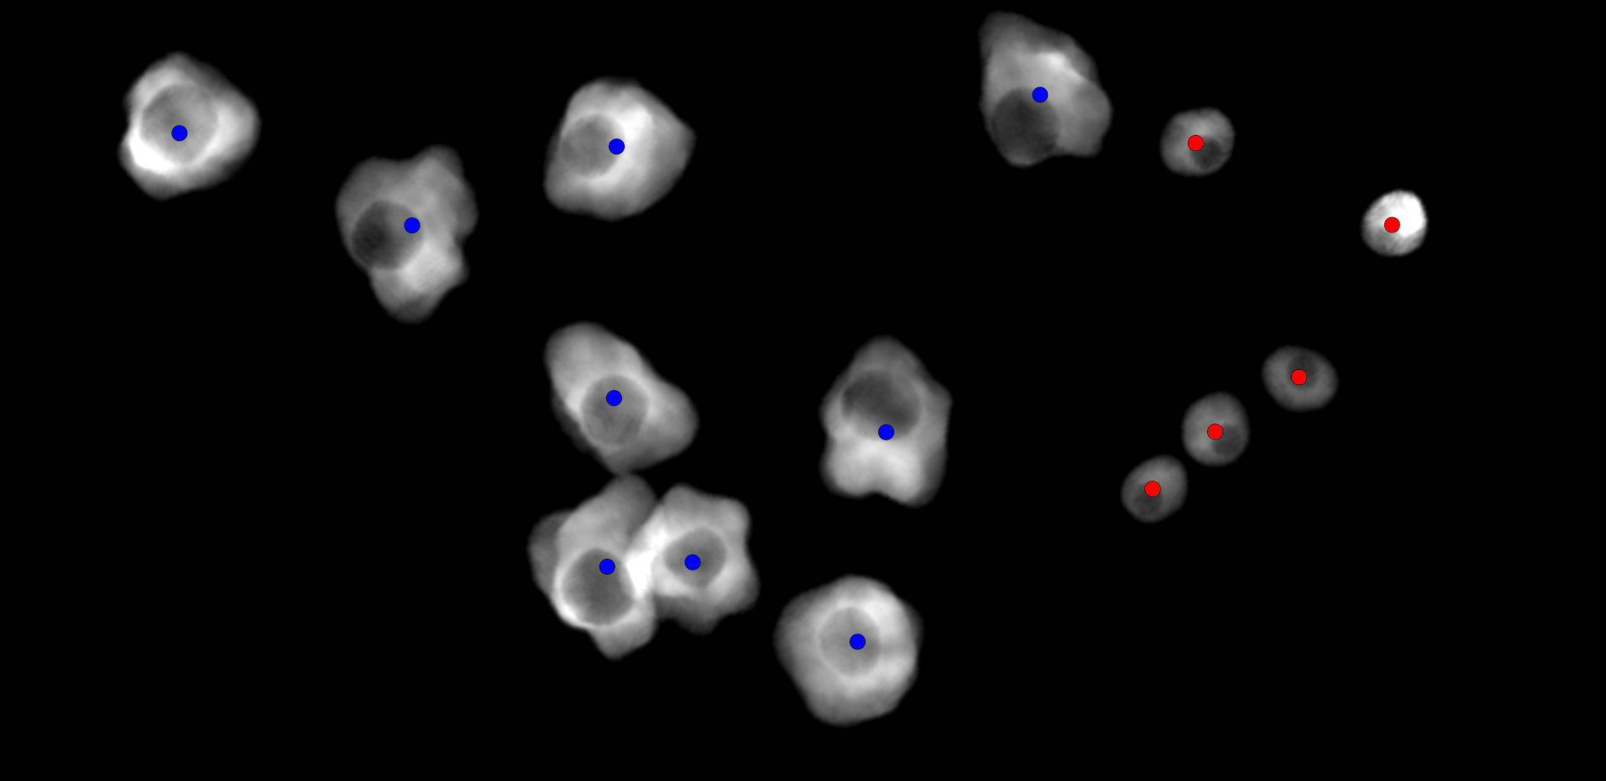
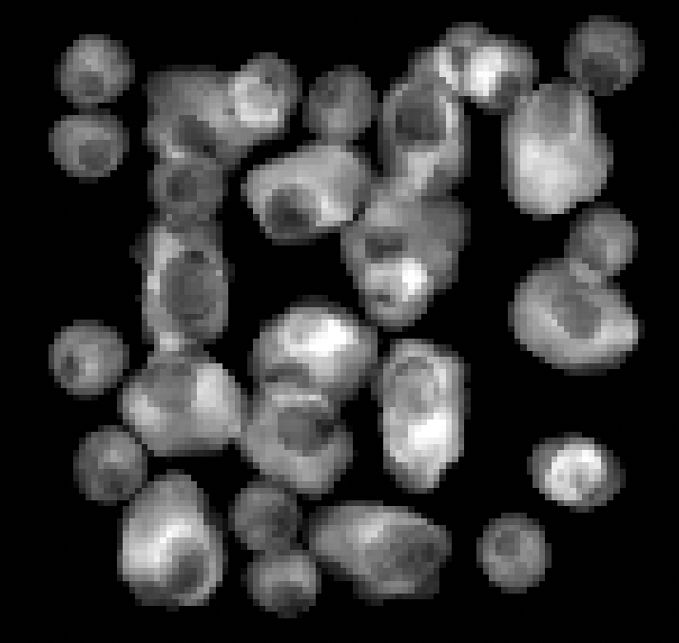
Aims
Aims of this project
Master Thesis project
1. Simulation framework
2. Computer vision system
 | Class | x | y | z
0 | Macrophage | 85 | 21 | 19
1 | Macrophage | 37 | 58 | 30
2 | Macrophage | 22 | 83 | 20
3 | Macrophage | 65 | 61 | 17
4 | Macrophage | 44 | 22 | 16
5 | Macrophage | 18 | 61 | 12
6 | Macrophage | 87 | 54 | 23
7 | Macrophage | 57 | 44 | 11
8 | Macrophage | 62 | 22 | 13
9 | Macrophage | 49 | 86 | 13
10 | Macrophage | 29 | 44 | 15
11 | Macrophage | 69 | 40 | 27
12 | Macrophage | 18 | 28 | 10
13 | T_Cell | 28 | 23 | 23
14 | T_Cell | 74 | 84 | 15
15 | T_Cell | 10 | 74 | 10
16 | T_Cell | 38 | 90 | 31
17 | T_Cell | 15 | 48 | 18
18 | T_Cell | 92 | 38 | 12
19 | T_Cell | 45 | 57 | 16
MBT-net
Notes:
Now, let's discuss this project's objectives. There are two primary goals: Create a system for simulating FAD autofluorescence stacks with immune cells in colon tissue with automatic annotation.
- Develop a neural network that will be trained and evaluated using simulated data.

Slide 11
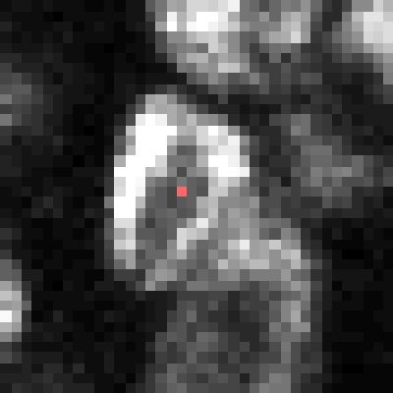
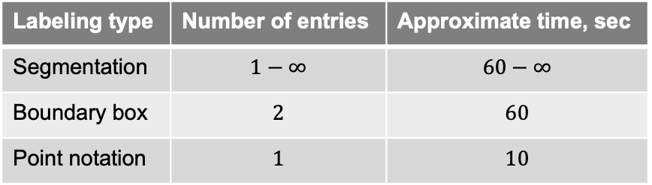
Machine Learning in image analysis
Motivation behind labeling type
Ways to label data for Deep Learning algorithm:
Segmentation – whole cell volume is labeled
Boundary box – 2 vertices are labeled (6 coordinates)
Point notation – 1 vertex is labeled (3 coordinates)
Common DL dataset size is bigger than 10 images, hence 10 * 500 cells = 5000 labeled cells.
1.
2.
3.
Table 1: comparison table between labeling approaches
Labeling type | Number of entries | Approximate time, sec
Segmentation | $$1−∞$$ | $$60−∞$$
Boundary box | $$2$$ | $$60$$
Point notation | $$1$$ | $$10$$
Notes:
As training datasets are essential for neural networks we must select an appropriate labeling type. There are three common methods for annotating image data:
- One example is segmentation. Every pixel belonging to a cell must be marked in segmentation.
- The next is Boundary box. In this type of labeling approach, cell volume is fitted into a rectangular region
- The final kind is point notation. It is the least common sort of annotation, but also the fastest one.
Why do we pick between labeling strategies? Because we wish to save time.
- The typical size of a training dataset is greater than 10 images, thus 10 x 500 cells is 5000 annotations. That is a lot of tedious work.
- Table one provides a comparison of time investments. Segmentation takes on average more than a minute to label a single cell. Boundary box requires 2 vertices (6 coordinates) which takes up to 60 seconds. And point notation requires only one vertex (3 coordinates) that takes up to 10 seconds.

Slide 12
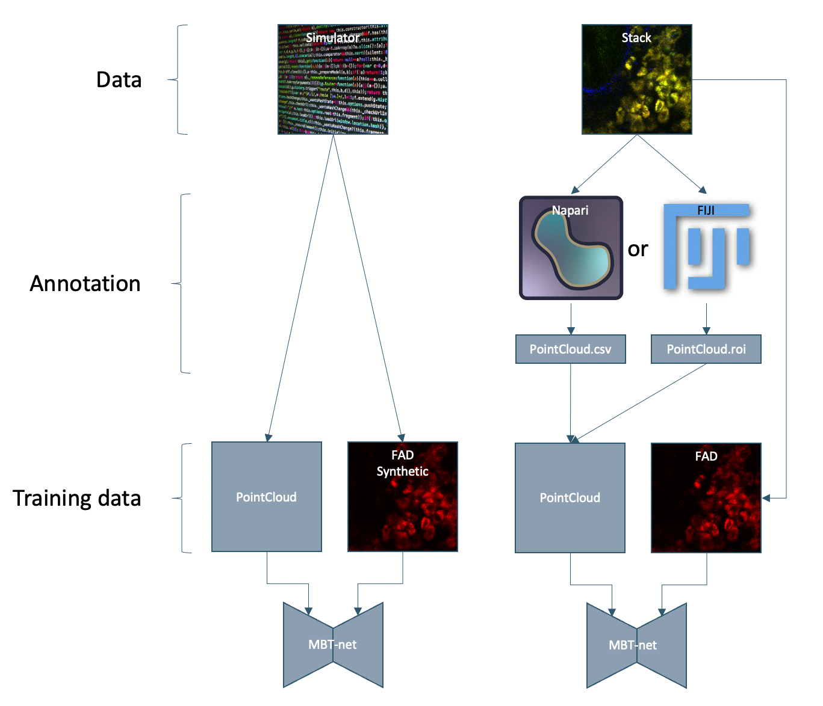
Machine Learning in image analysis
Neural Network Training
Current project state
Future work
Current project state
Cell simulator is developed and used to generate training data for MBT-net to evaluate its performance
MBT-net is designed, and trained on artificial data as proof of concept
Future work
Acquisition of image stacks with researched parameters
Real stacks manual annotation
Training MBT-net on real stacks
Using MBT-net for cell quantification and classification
Notes:
Why we don't use manually annotated data? Why to go with simulator? First goal is to test new ways of labeling that would minimize effort from pathologists. A second goal is to test which acquisition parameters and network architecture could be suitable for this task. All of this must be tested before experiment conduction and annotation.
- In the current state of the project, a cell simulator has been developed and is being utilized to generate training data for MBT-net in order to evaluate its performance.
As proof of concept, MBT-net is created and trained using artificial data.
- Future work will involve the acquisition of image stacks with researched parameters. Point notation will be manually applied to real stacks. Then, MBT-net will be trained on actual stacks. And we will utilize MBT-net to quantify and classify cells in volumetric pictures.

Slide 13
Results: Cell Simulator

Slide 14
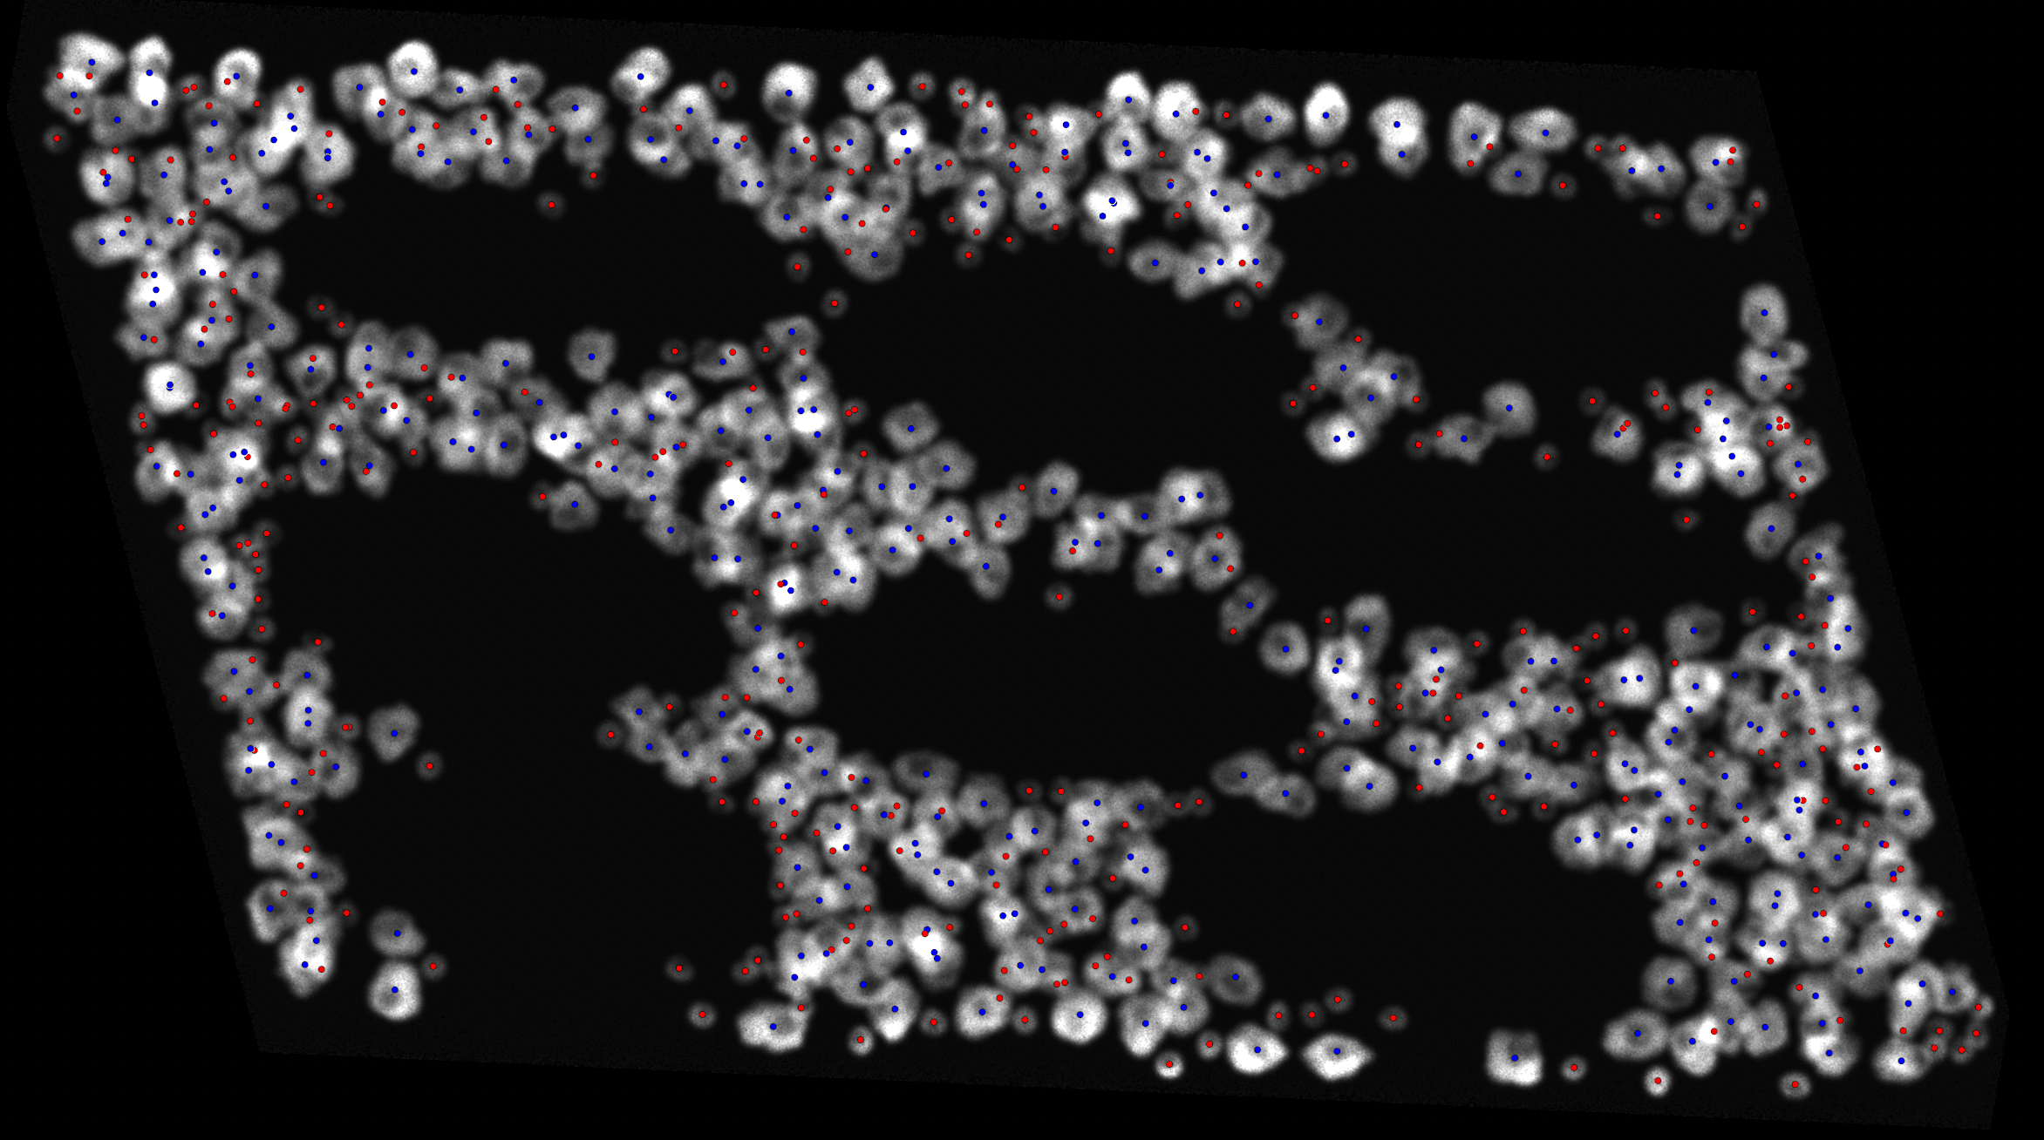
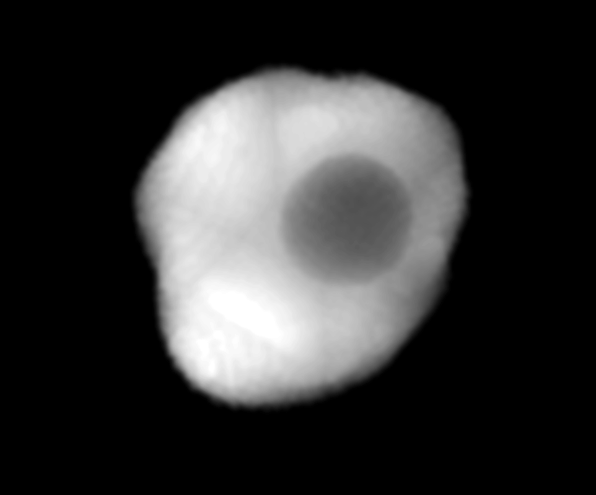
Cell Simulator
A framework for dataset simulation
Cell Simulator
A software framework for simulation of MPM stacks in FAD channel of immune cells in colon tissue.
Simulates different cell types with variable parameters (size, shape)
Simulates volumetric stacks
Simulates crypts
Examples of simulated cells
Notes:
A software framework for simulation of MPM stacks in FAD channel of immune cells in colon tissue.
It can simulate different cell types with variable parameters (size, shape). It can simulate volumetric stacks, and even mimic presence of crypts.

Slide 15
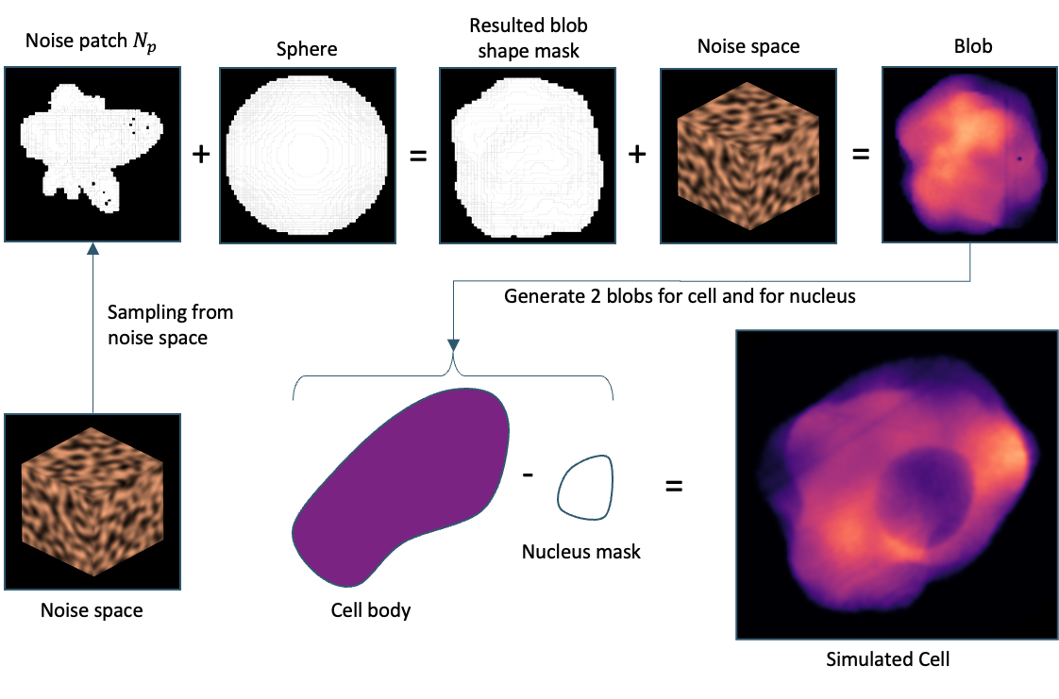
Cell Simulator
Simulation of immune cell
Notes:
Let's see how the novel cell generation seqгence works. At first a gradient noise space is generated.
- Than a sphere is sampled from it to generate a noise patch.
- This noise patch is added to sphere in spherical coordinates
- to create a cell shape mask.
- Which is seqentially sampled from noise domain again, to create intensity inhomogenity,
- which results in cell cytoplasm blob. To complete cell generation,
- nucleus mask is generated the same way as cytoplasm but with different parameters, and then it is subtracted from cytoplasm volume
- to complete cell.

Slide 16
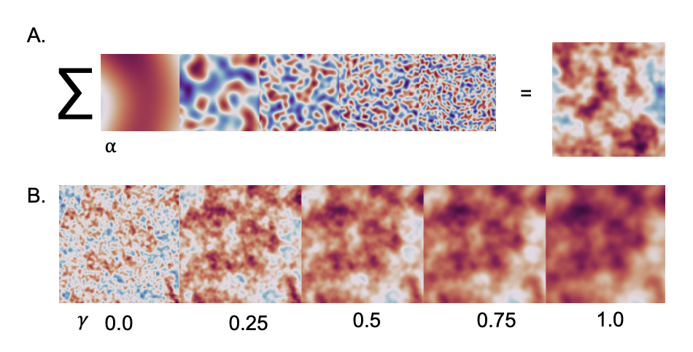
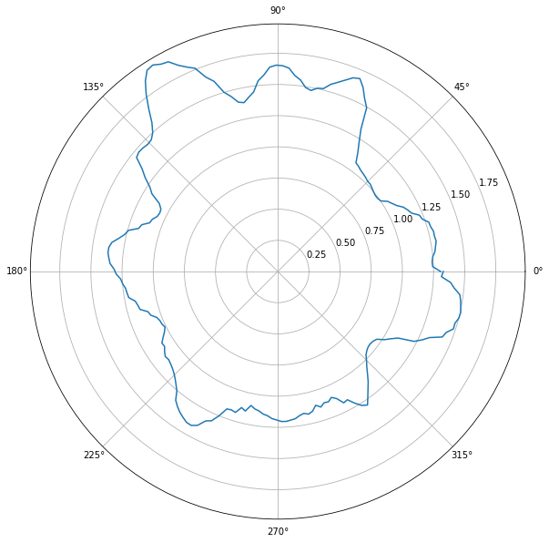
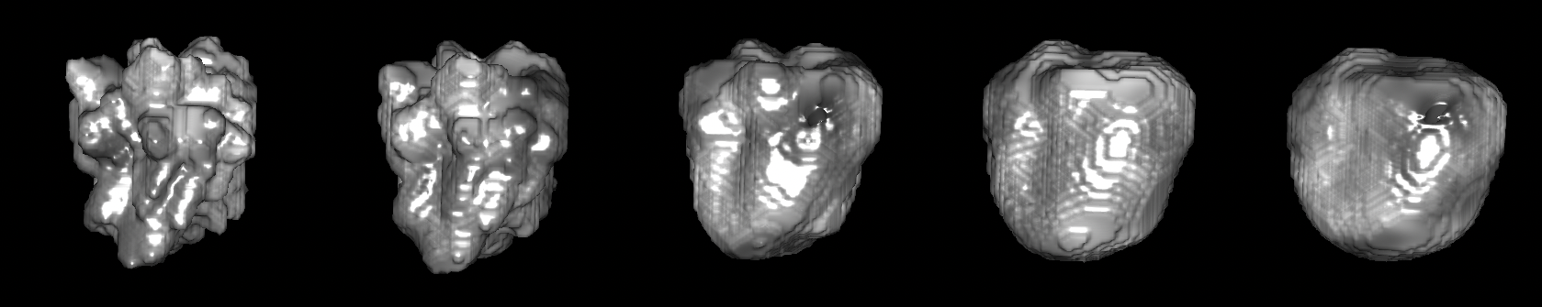
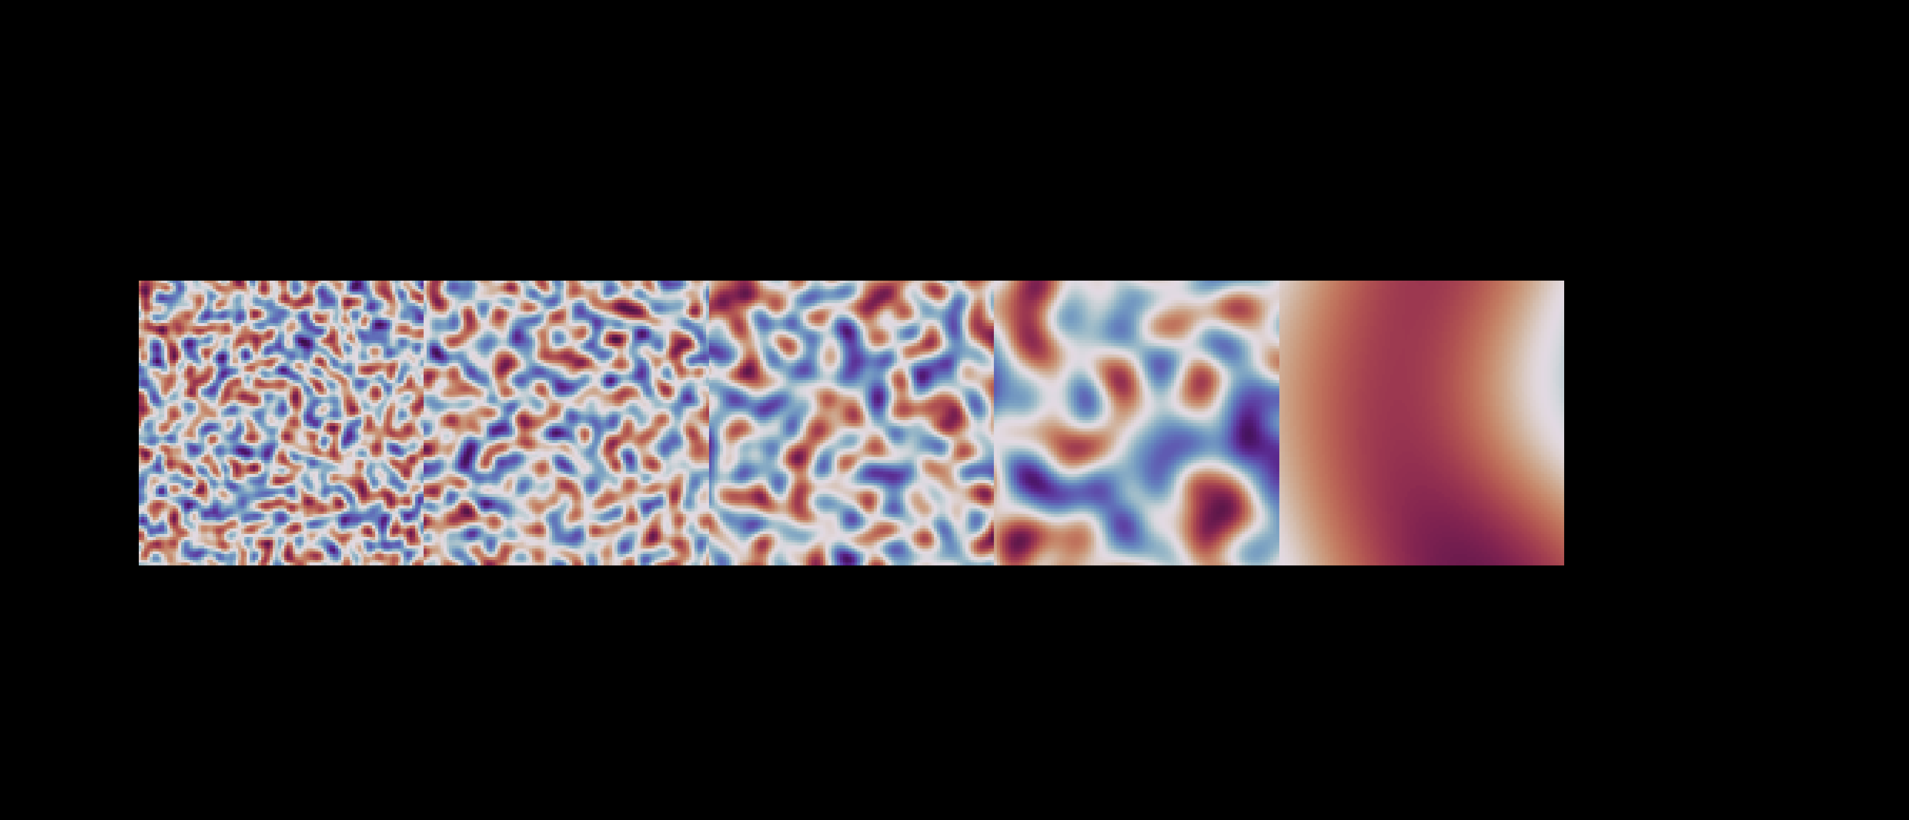

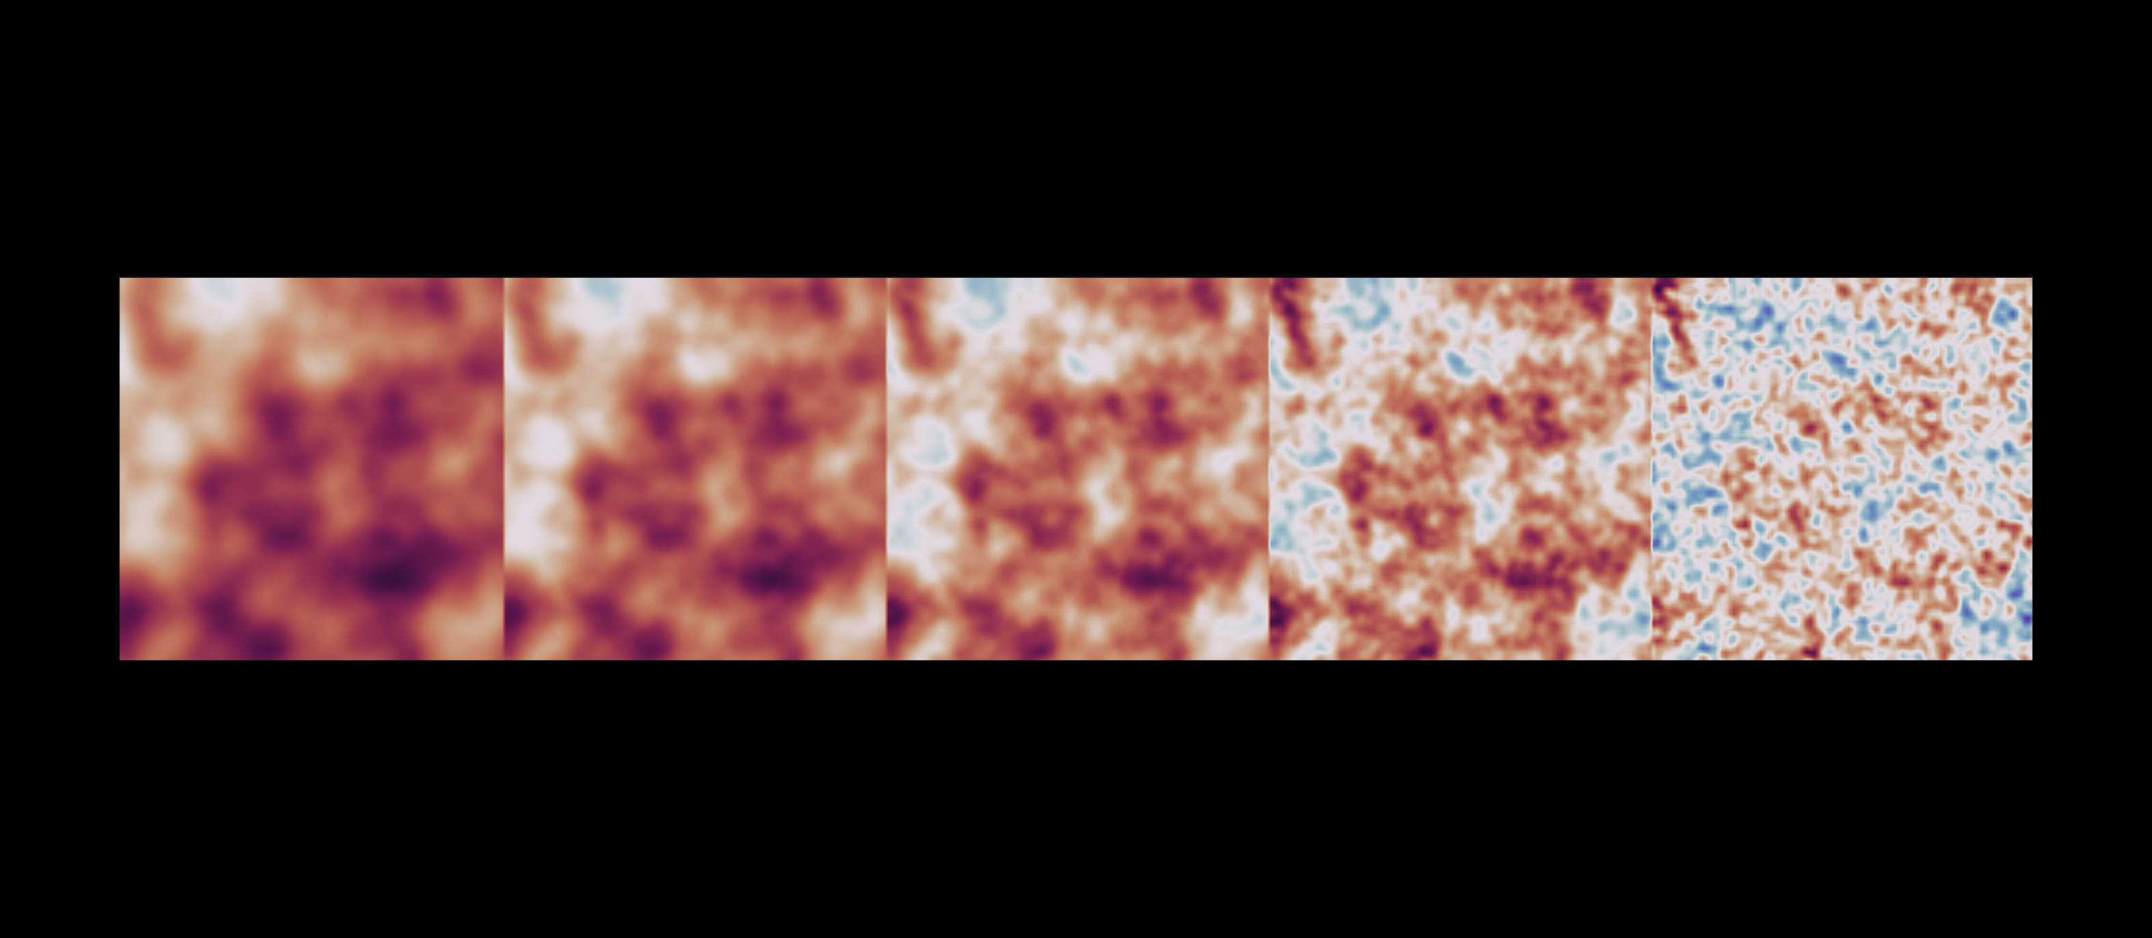
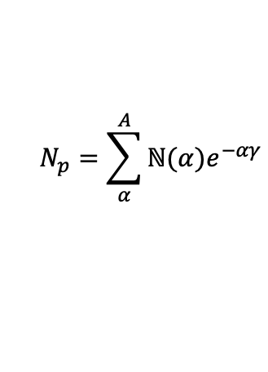
Cell Simulator
Parameters to compute cell shape from opensimplex noise domain
$$N_{p}=\sum_{α}^{A}{ℕ(α)e^{−αγ}}$$
By changing parameters, different cell types could be generated
A.
∑
=
⍺
B.
𝛾
0.0
0.25
0.5
0.75
1.0
Notes:
Let's examine how noise space is formed, as this is what dictates the shape of the cell.
To generate noise domain, a small number of domains of varying scales are generated and added.
This produces a noise domain, which may be sampled in spherical coordinates
to form a cell shape.
To alter noise domain frequencies a modulation function was utilized. By changing the value of gamma, the effect of high frequencies on the resulting domain can be changed.
Here you can observe how gamma parameter changes cell shape. By changing parameters, different cell types could be generated.

Slide 17
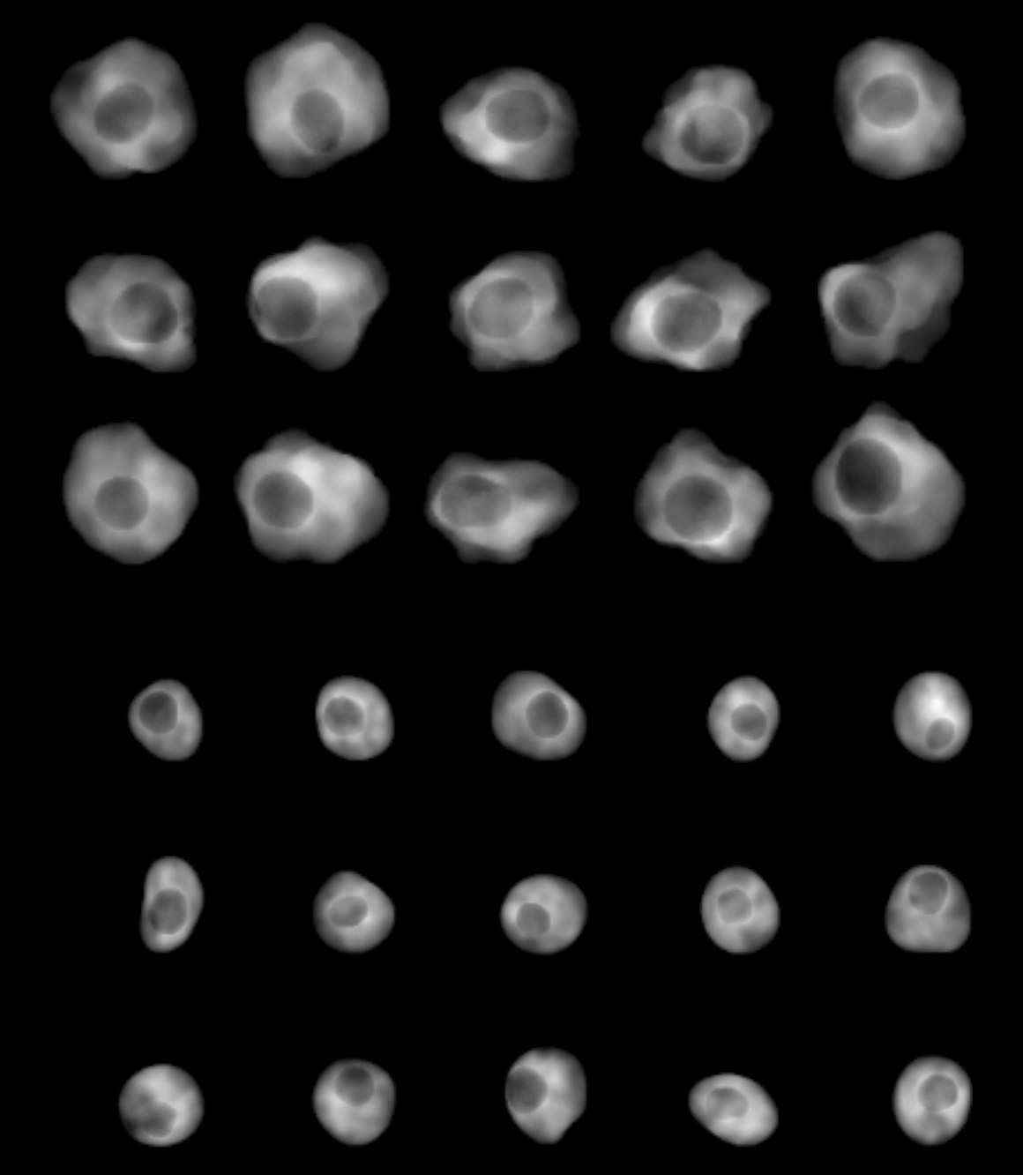
Cell simulator
Simulation results of two cell types
Simulated macrophages
Table 2: spreadsheet of simulation parameters
Cell type | Cytoplasm size, µm | Nucleus size, µm | 𝛾, nucleus shape | c, nucleus shape | 𝛾, cytoplasm shape | c, cytoplasm shape
Macrophage | 15 | 6 | 1.5 | 2.0 | 0.5 | 1.5
T-Cell | 9 | 4 | 1.5 | 2.0 | 1.5 | 2.0
Simulated T-Cells
Notes:
In Table 2 you can find the simulation settings used for simulation of macrophages and T-cells.
- And here is the result. Two cell types looks distinguishable and mimic real cell appearance.

Slide 18
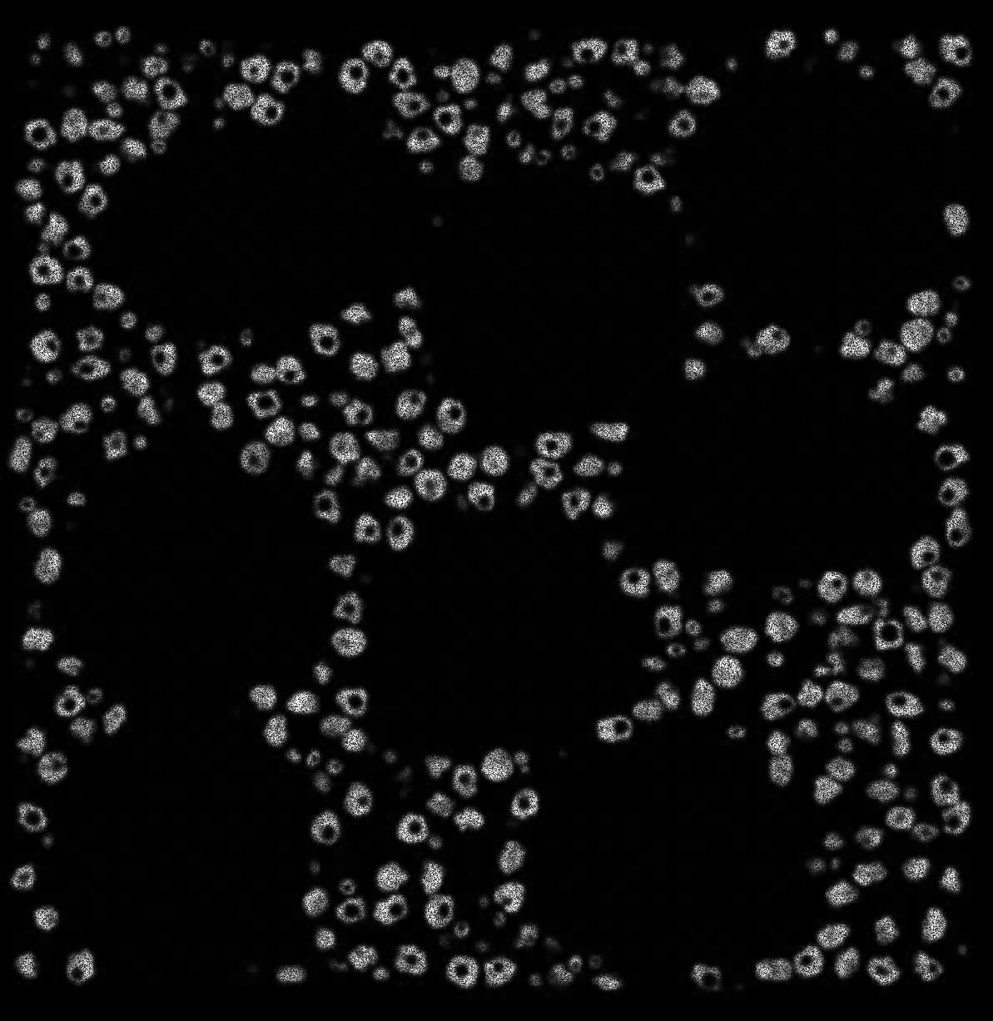
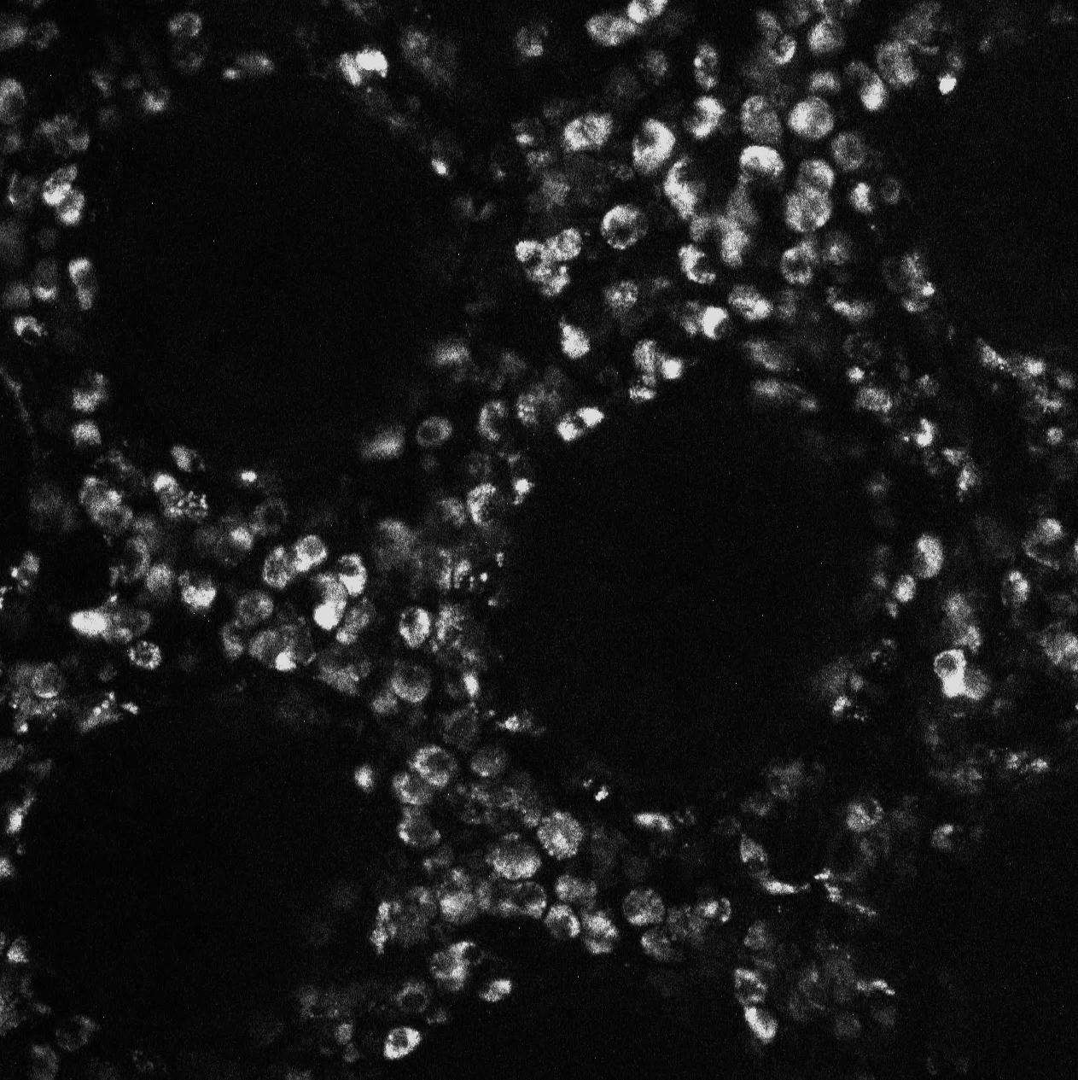

Cell Simulator
Simulation results
Simulated stack layer
Real stack layer
Simulated volume view
50 µm
Macrophage
T-cell
100 µm
100 µm
Notes:
On the left can be seen a simulated stack layer. The real stack layer is depicted in the middle, while a volumetric view of simulated cells is depicted on the right.

Slide 19
Results: Neural Network

Slide 20
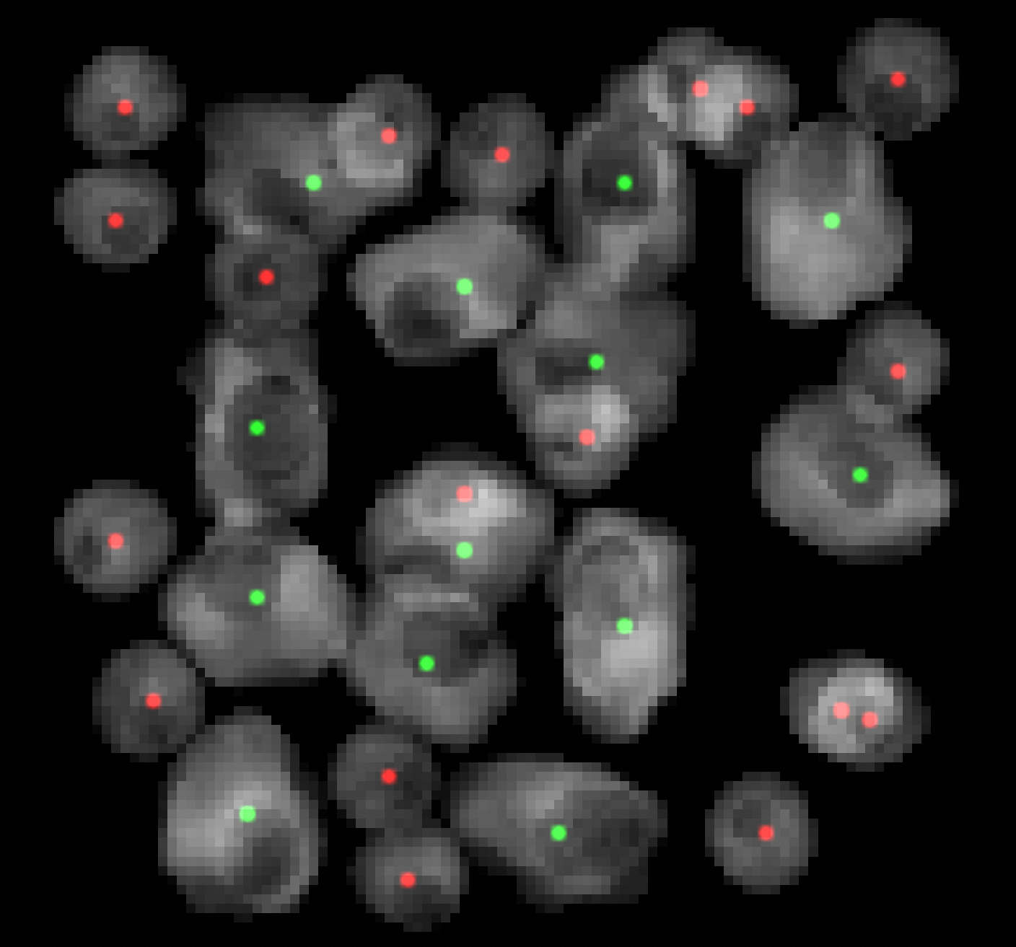
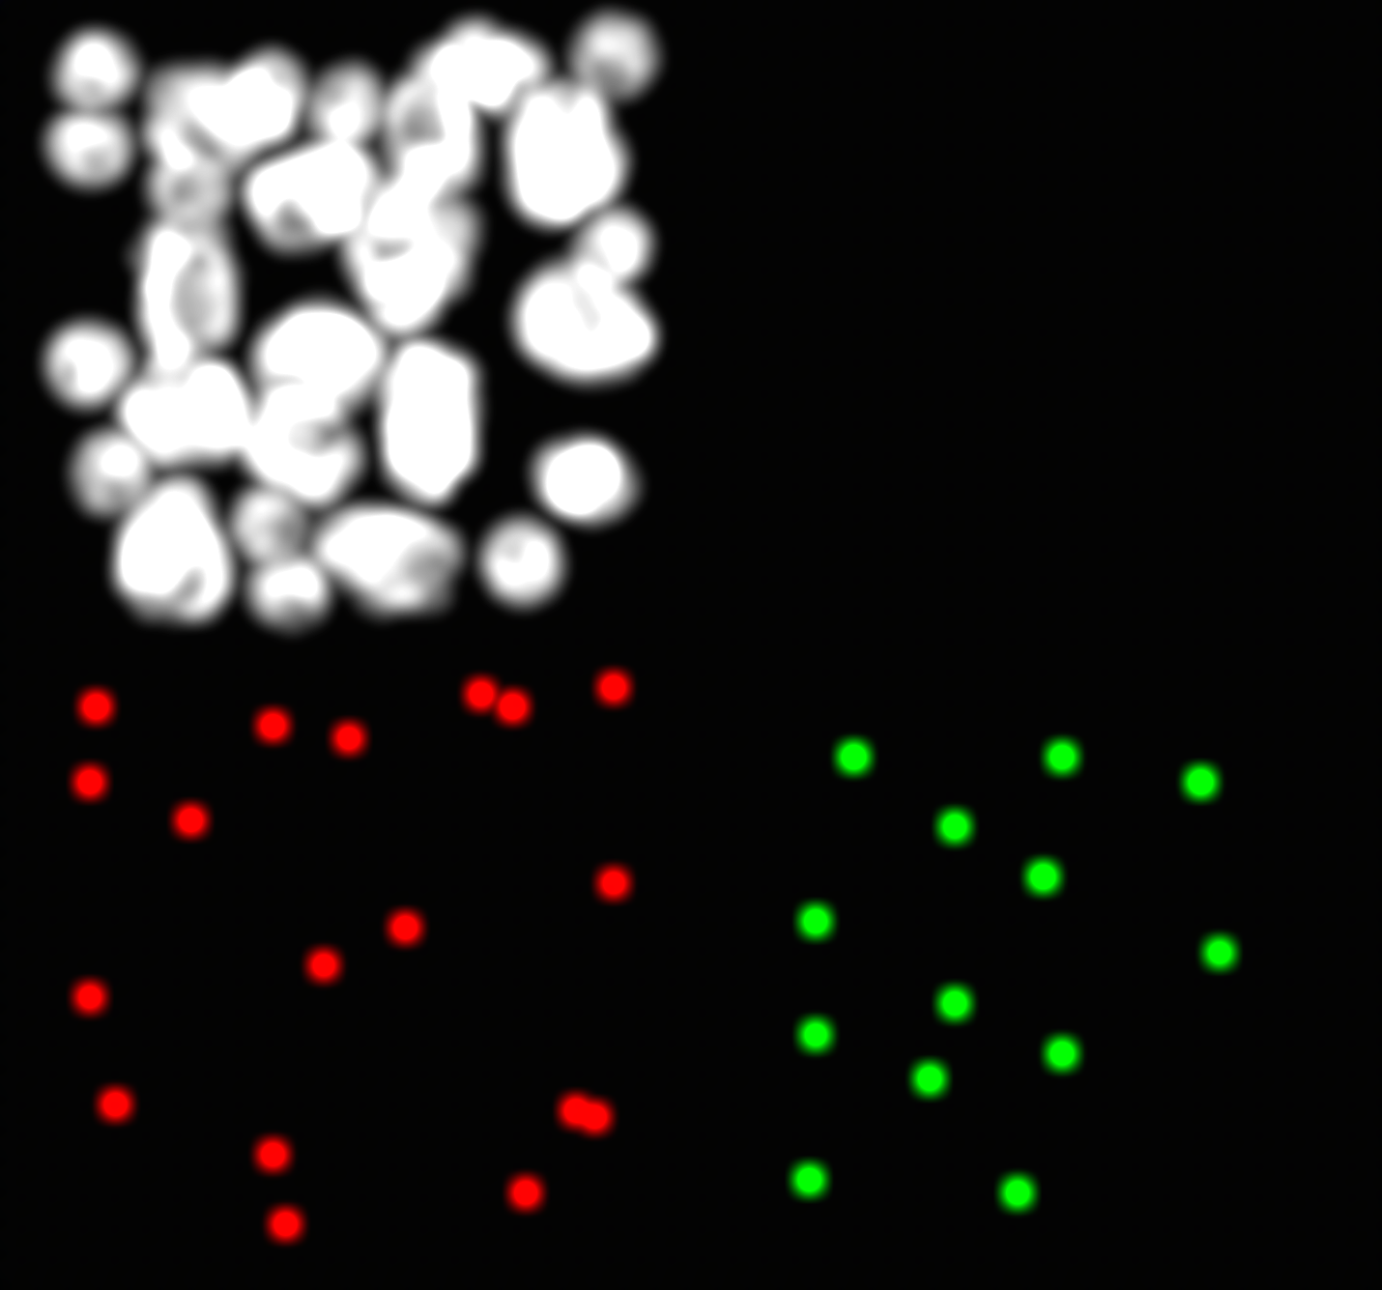
Neural Network
Exploitation phase for Deep Learning approach
Aim: Network predicts each cell position for each class
 | Class | x | y | z
0 | Macrophage | 85 | 21 | 19
1 | Macrophage | 37 | 58 | 30
2 | Macrophage | 22 | 83 | 20
3 | Macrophage | 65 | 61 | 17
4 | Macrophage | 44 | 22 | 16
5 | Macrophage | 18 | 61 | 12
6 | Macrophage | 87 | 54 | 23
7 | Macrophage | 57 | 44 | 11
8 | Macrophage | 62 | 22 | 13
9 | Macrophage | 49 | 86 | 13
10 | Macrophage | 29 | 44 | 15
11 | Macrophage | 69 | 40 | 27
12 | Macrophage | 18 | 28 | 10
13 | T_Cell | 28 | 23 | 23
14 | T_Cell | 74 | 84 | 15
15 | T_Cell | 10 | 74 | 10
16 | T_Cell | 38 | 90 | 31
17 | T_Cell | 15 | 48 | 18
18 | T_Cell | 92 | 38 | 12
19 | T_Cell | 45 | 57 | 16
Conventional threshold method for cell quantification
MBT-net
1.Input stack
2.Neural Network
3.Output Probability density function (PDF)
4.PDF for each class
5.Postprocessing
6.Results of cell coordinates
Notes:
Neural network. What is its purpose? It must forecast the position of each cell in each class. How will it be implemented?
First, a simulated stack is fed into the MBT-net.
.
The network forecasts the probability density function. It shows a probability of cell existince at a given pixel
We collect PDF for each class
post-process it using a simple threshold
and extract information about cells, their location, and class.

Slide 21
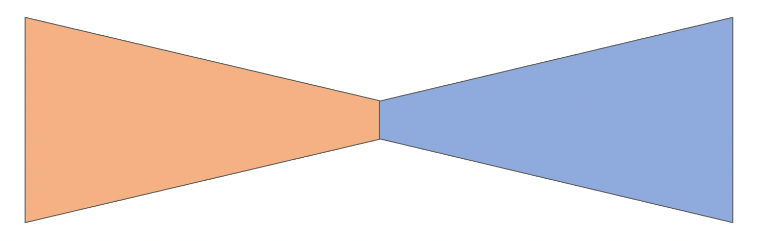

Neural Network
Architecture of MBT-net
Encoder
Decoder
+
+
+
Softmax
T-Cell
Macrophage
Background
18 x 128 x 128 x 28
36 x 66 x 66 x 16
18 x 128 x 128 x 28
9 x 252 x 252 x 52
MBT-net
9 x 252 x 252 x 52
1 x 500 x 500 x 100
3 x 500 x 500 x 100
Encoder block
Decoder block
BatchNorm
Conv3D
LeakyReLU
Conv3D
LeakyReLU
MaxPool
Interpolation
BatchNorm
Conv3D
LeakyReLU
Conv3D
LeakyReLU
Output
Compress data
Extract features
Reconstruct data
Extract features
Notes:
MBT-net is based on U-net and LinkNET, two common segmentation task architectures. MBT-net is an encoder-decoder network that has skipped connections.
The encoder block of a network has two functions: data compression and feature extraction. The stack's spatial resolution decreases as its number of channels (features) increases.
You can see how shape of stack changes from left to right. In the bottleneck of the network, the stack shrinks by a factor of 7.5 and the number of features increases to 36.
The next block is a decoder. Its objective is to extract features and reconstruct data from low-resolution input and encoder output. How does it work? It interpolates the image using trilinear interpolation, and in order to obtain spatial information
it sums the output of the encoder block with input tensor.
-This operation is repeated for each resolution that matches input/output. In the network end Softmax function, also known as normalized exponential function, is applied to span pixels in probabilistic range from 0 to 1.
And in the end we've got 3 stacks of original shape, that predicts three classes: T-cell, Macrophage and Background.

Slide 22
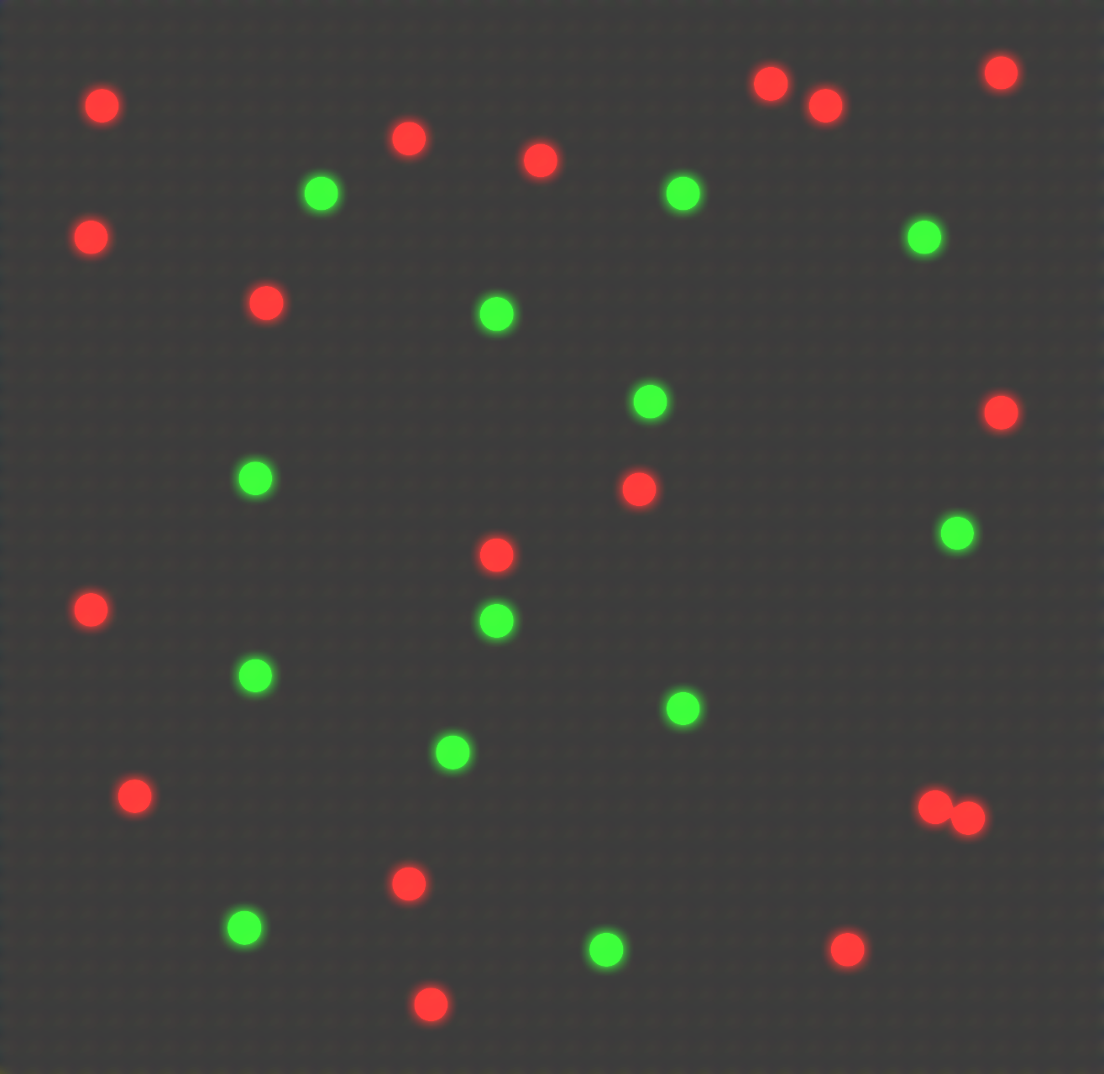
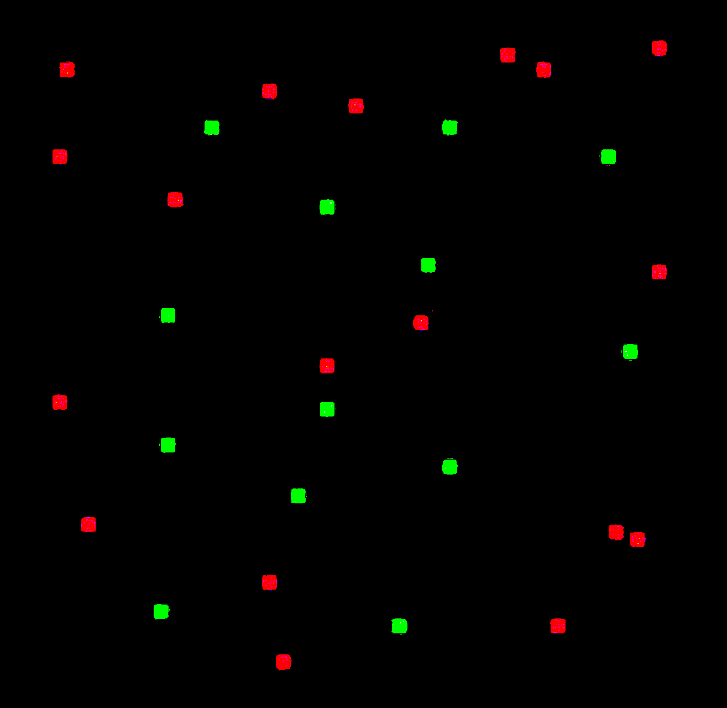
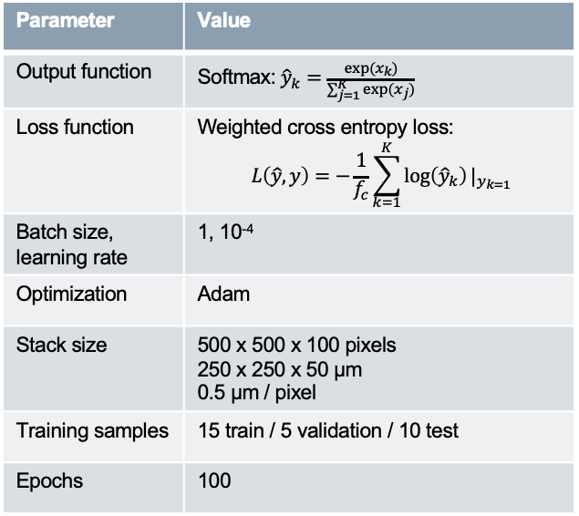
Neural Network
Training phase of MBT-net
Aim of training: minimize difference between network output and ground truth
Ground truth
Table 3: MBT-net training parameters
Data sample
Output
Parameter | Value
Output function | Softmax:${\hat{y}}_{k}=\frac{exp(x_{k})}{\sum_{j=1}^{K}{exp(x_{j})}}$
Loss function | Weighted cross entropy loss: $$L\left(\hat{y},y\right)=−\frac{1}{f_{c}}\sum_{k=1}^{K}{\log\left({\hat{y}}_{k}\right)}|_{y_{k=1}}$$
Batch size, learning rate | 1, 10⁻⁴
Optimization | Adam
Stack size | 500 x 500 x 100 pixels 250 x 250 x 50 µm 0.5 µm / pixel
Training samples | 15 train / 5 validation / 10 test
Epochs | 100
-
MBT-net
Loss
Cell Simulator
Notes:
Now let's see how training is done.
We use cell simulator to produce stacks and ground truth pdfs.
We feed a stack to network and it outputs something. It does not look as our ground truth data at all, because network is not trained yet. To fix that we introduce ground truth pdf and
we force network to minimize difference between its output and ground truth.
This difference, known as loss is being used in backpropagation process to update network's weights and improve its output prediction.
In table 3 you can observe successful training parameters for this project. As loss function we used a weighted cross entropy loss, optimizer Adam, and 20 simulated stacks, 15 for training, 5 for validation and 10 for testing.

Slide 23
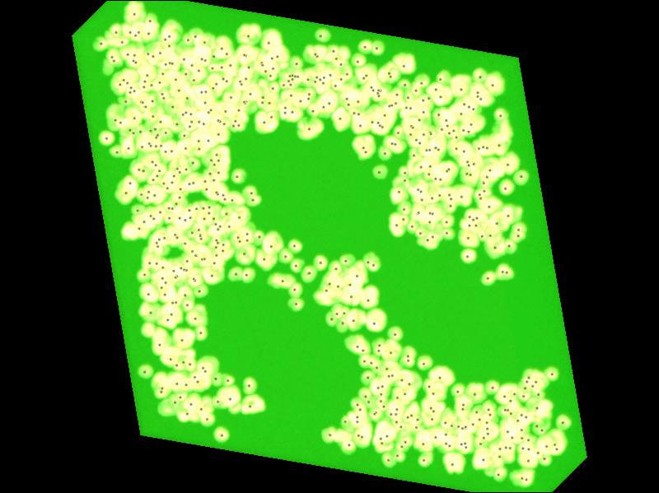
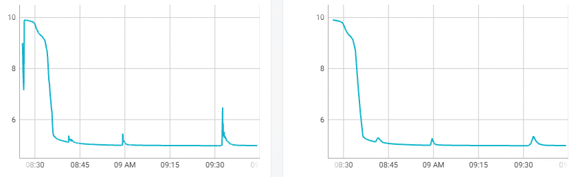
Neural Network
Training demonstration
Train loss
Loss, ul
Training time
Validation loss
Loss, ul
Training time
Video demonstrates MBT-net performance during trainging phase
Notes:
This slide illustrates how MBT-net prediction was refined during the training process. Each epoch output gradually improves in quality. Cellular regions become increasingly localized and are consequently segregated. The validation and training loss curves are displayed on the right. It demonstrates how the network improves during training time.

Slide 24
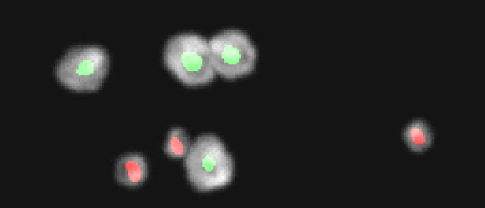
Neural Network
Visualization of output
Max projection of MBT-net prediction on not densely populated stack
Notes:
Now I want to show you a zoomed image of network prediction. Macrophages and T-cells are localized and predicted correctly.

Slide 25
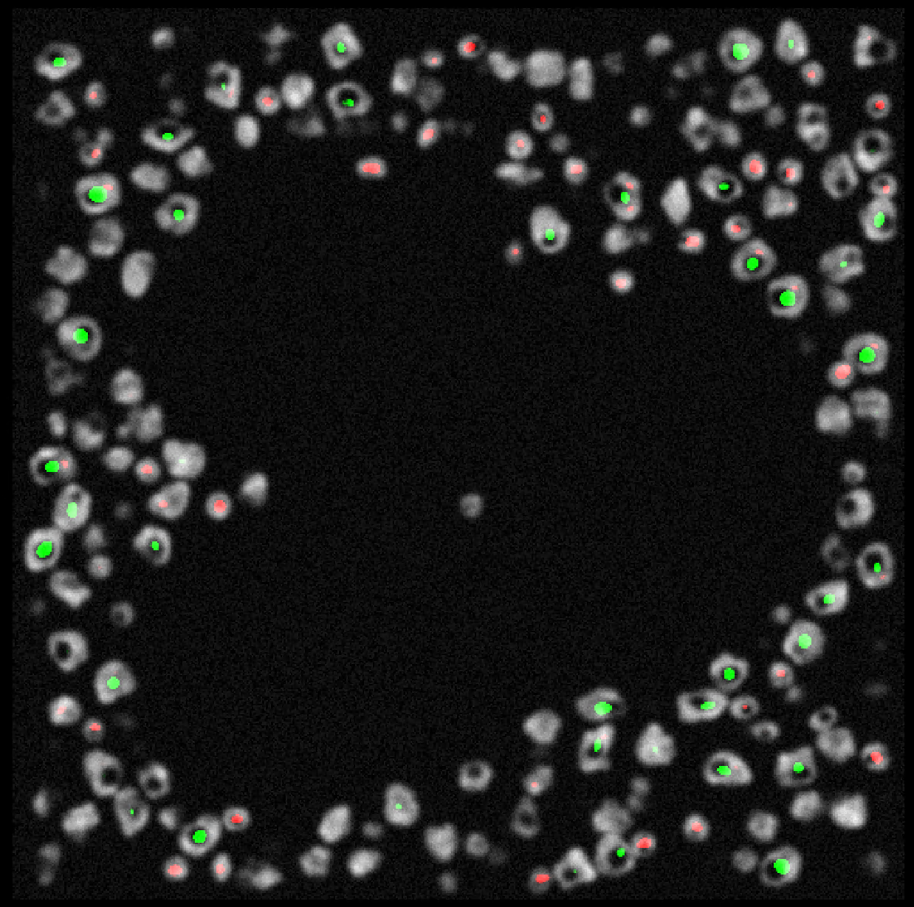
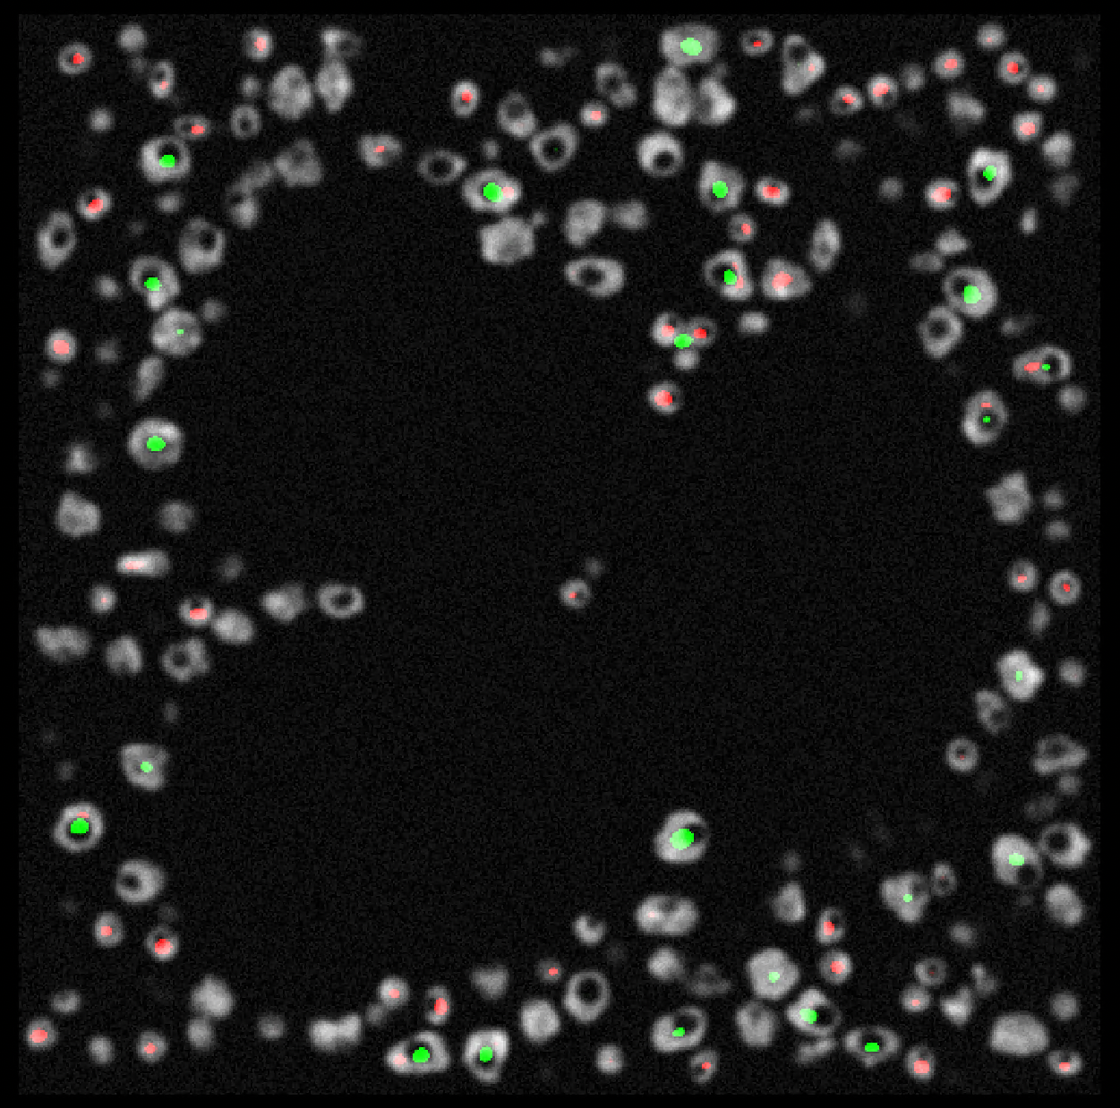
Neural Network
Visualization of output
A
B
Example of comparatively high cell localization
Example of comparatively low cell localization
Notes:
There is an additional instance of a densely populated stack. The network behaved well in this instance. Cells are accurately located. But it does not work always.
On the image to the right is an illustration of poor cell localization performance.
Here in frame A, three T-cells have created a cluster, which the network misidentifies as a macrophage.
Certain macrophages on this image exhibit double prediction, as illustrated here in frame B.

Slide 26
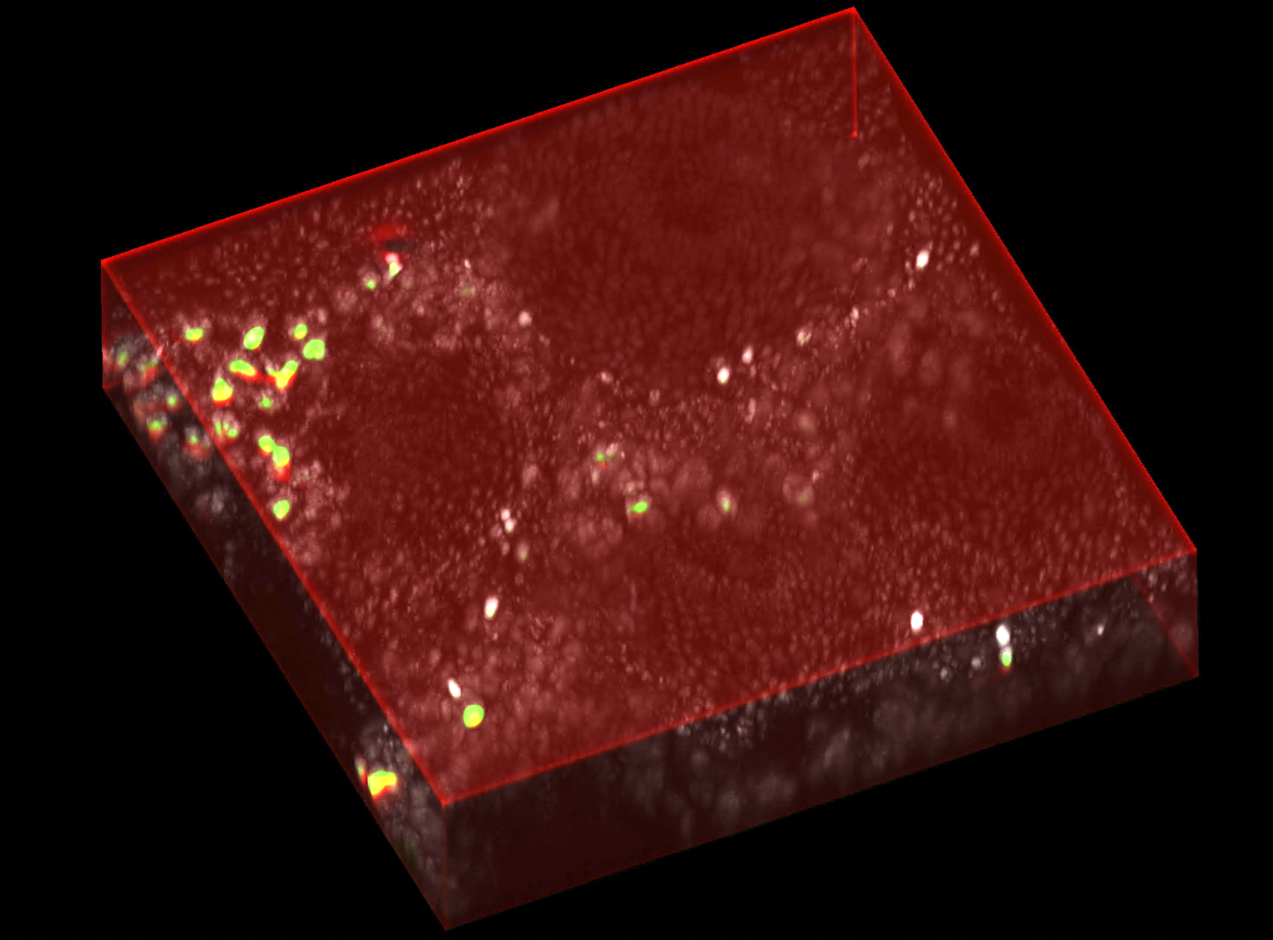
Neural Network
MBT-net view on real data
Network output given real data
Notes:
Following our curiosity as an experiment, we attempted to feed the network a real stack. The outcome can be observed on this slide. As can be seen, it finds very few cells on this stack. Clearly, simulated data cannot adequately replicate the complexity of real data to develop networks capable of handling real data.

Slide 27
Results: Quantification performance

Slide 28
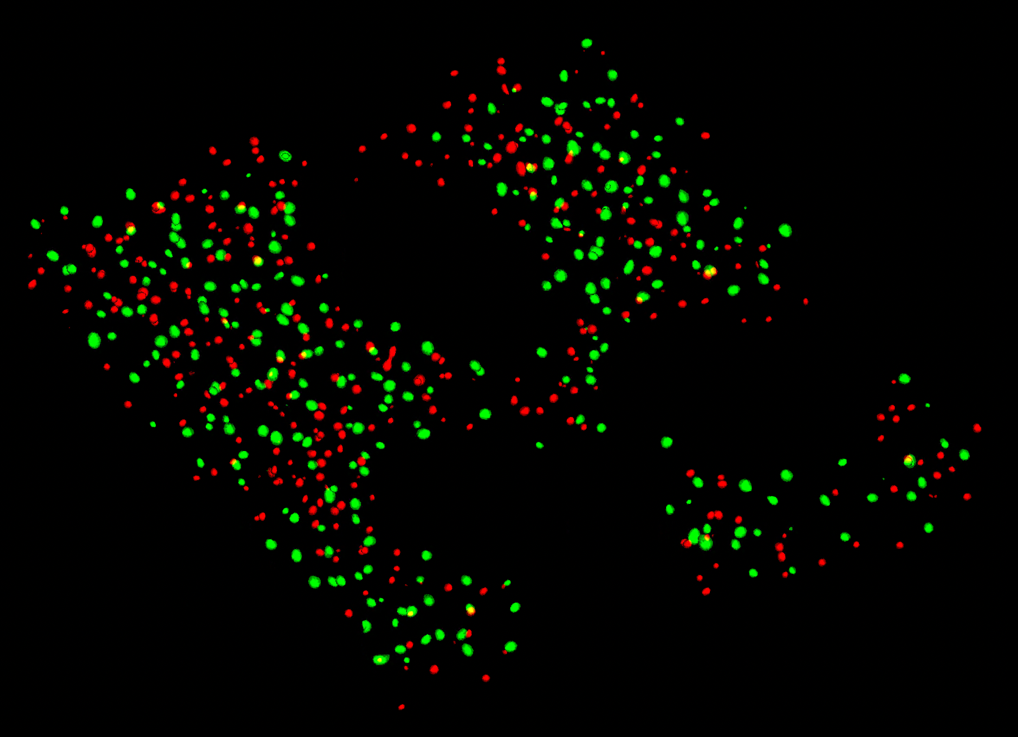
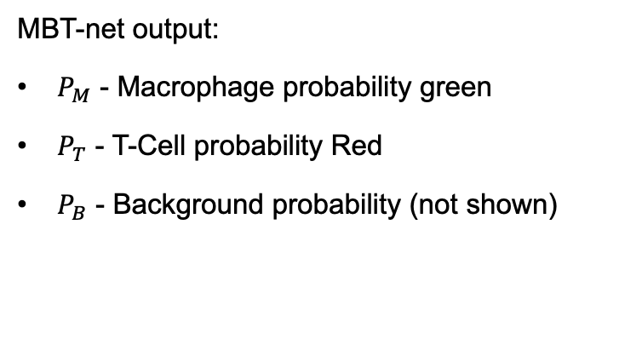
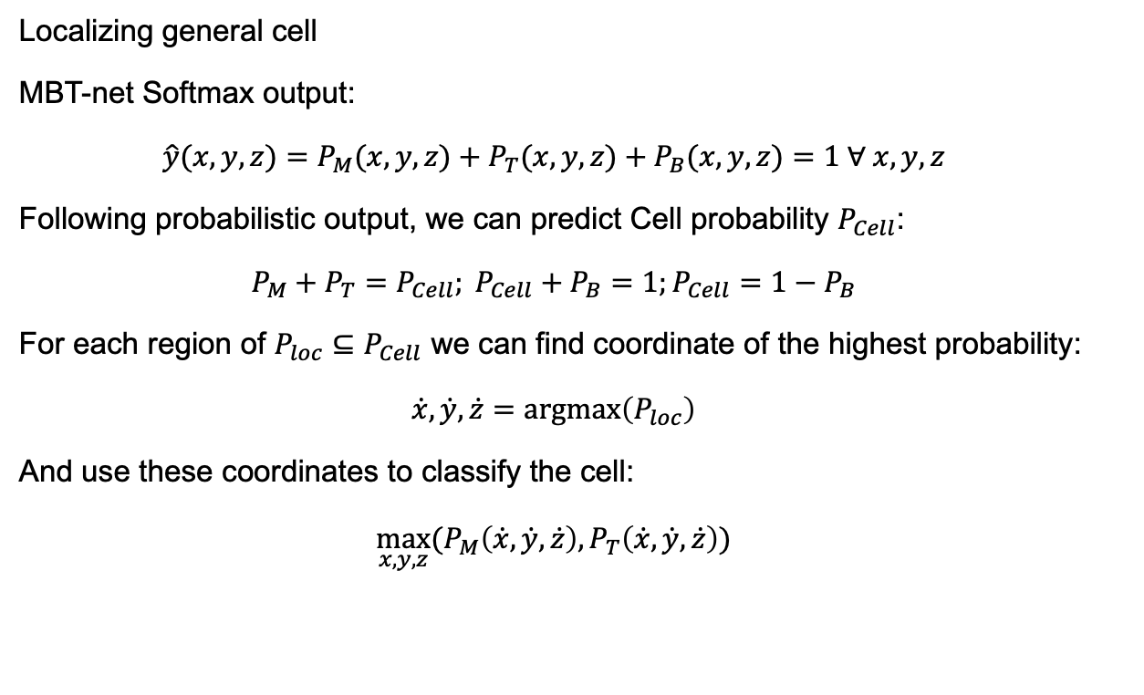
Quantification of cells
Cell quantification based on MBT-net output
MBT-net output:
$P_{M}$ - Macrophage probability green
$P_{T}$ - T-Cell probability Red
$P_{B}$ - Background probability (not shown)
Localizing general cell
MBT-net Softmax output:
$$\hat{y}(x,y,z)=P_{M}(x,y,z)+P_{T}(x,y,z)+P_{B}(x,y,z)=1 ∀ x,y,z$$
Following probabilistic output, we can predict Cell probability $P_{Cell}$:
$$P_{M}+P_{T}=P_{Cell}; P_{Cell}+P_{B}=1;P_{Cell}=1−P_{B}$$
For each region of ${P_{loc}⊆P}_{Cell}$ we can find coordinate of the highest probability:
$$\dot{x},\dot{y},\dot{z}=argmax\left(P_{loc}\right)$$
And use these coordinates to classify the cell:
$$\max_{x,y,z}{(P_{M}\left(\dot{x},\dot{y},\dot{z}\right),P_{T}\left(\dot{x},\dot{y},\dot{z}\right))}$$
PDF of Macrophage and T-Cell
Notes:
For cell quantification, it is necessary to process the network output. Consider pm, pt, and pb as macrophage, T-cell, and background probability.
To identify cells, we created the following method.
Given that a network output is passed through a softmax function, the sum of probabilities for each pixel will always equal to one. That is a property of softmax function.
We can determine the likelihood of cell existence in a given volume based on this property. The sum of probabilities for both cell types can be written as Pm+Pt = Pcell. This quantity pcell equals one minus pb, given the softmax property.
For each region ploc belonging to a pcell, the coordinate with the highest cell probability is determined.
In the final stage, we compare the likelihood of cell and t-cell at this site to determine the final cell class.

Slide 29
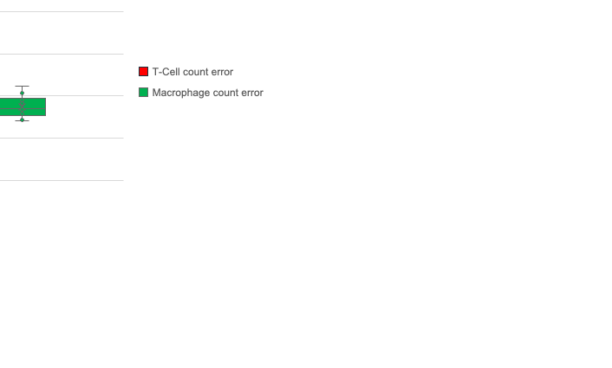
Quantification of cells
MBT-net performance
Table 4: MBT-net cell counting performance on test data
Stack # | Ground truth |  | Prediction |  | Misclassified %
 | Macrophage | T-Cell | Macrophage | T-Cell | Macrophage | T-Cell
0 | 336 | 364 | 312 | 366 | 7% | 1%
1 | 314 | 301 | 287 | 298 | 9% | 1%
2 | 285 | 313 | 262 | 317 | 8% | 1%
3 | 327 | 347 | 293 | 373 | 10% | 7%
4 | 329 | 353 | 299 | 364 | 9% | 3%
5 | 325 | 302 | 294 | 318 | 10% | 5%
6 | 340 | 308 | 302 | 325 | 11% | 6%
7 | 237 | 237 | 217 | 245 | 8% | 3%
8 | 324 | 308 | 301 | 317 | 7% | 3%
9 | 303 | 329 | 279 | 347 | 8% | 5%
 |  |  |  | Deviation | 1% | 2%
 |  |  |  | Average | 9% | 4%
Notes:
Next, 10 test stacks were generated to evaluate the performance of the trained mbt-net. The network estimated the number of macrophages and T-cells with a maximum error of 11%.
- On this graph, the error distribution of misclassified cells for given classes may be viewed. Now we can draw the conclusions

Slide 30
Conclusion

Slide 31
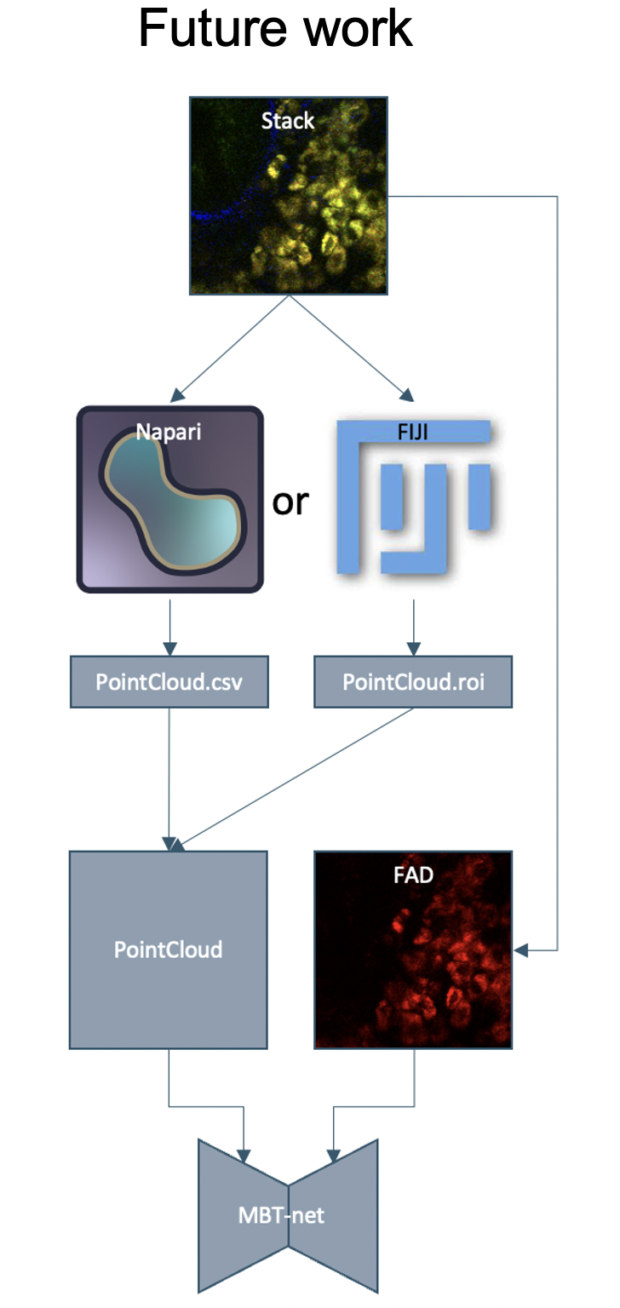
Conclusions and future work
Conclusions:
01
Simulator for creating 3D data-sets is developed
02
Neural Network for quantification of immune cells in volumetric images is developed
03
After training on synthetic data 90% counting/classification accuracy is guaranteed
Future work:
01
Training on real data
02
Imporvements of MBT-net
Notes:
Simulator for creating 3D data-sets is developed. It can be used for generation of arbitrary volumetric data and not only for immune cells in FAD channel.
Neural Network for quantification and classification of immune cells in volumetric images is developed
As a result after training on synthetic data 90% counting/classification accuracy was achieved
Future work:
Stacks with acquired acquisition parameters will be captured and used for training MBT-net.
MBT-net will be improved to count and classify cells even better, and after training on real data will be used for research purposes.

Slide 32
Thank you for your attention!
Notes:
Thank you for your attention. Now I would be glad to answer your questions.

Slide 33
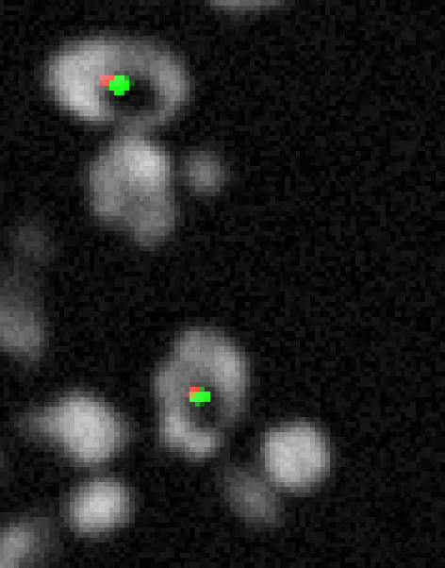
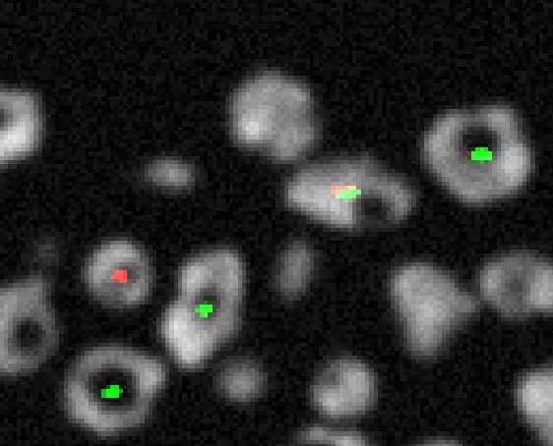
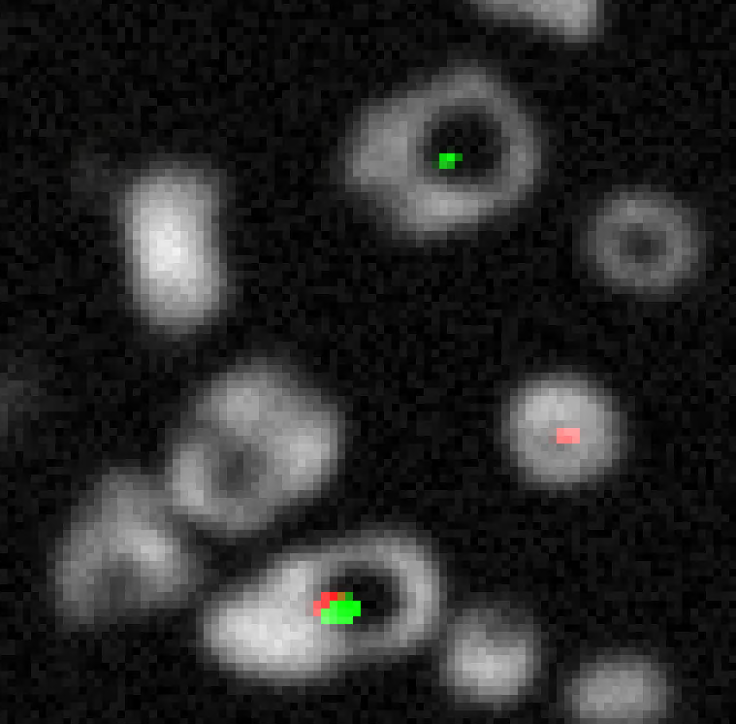
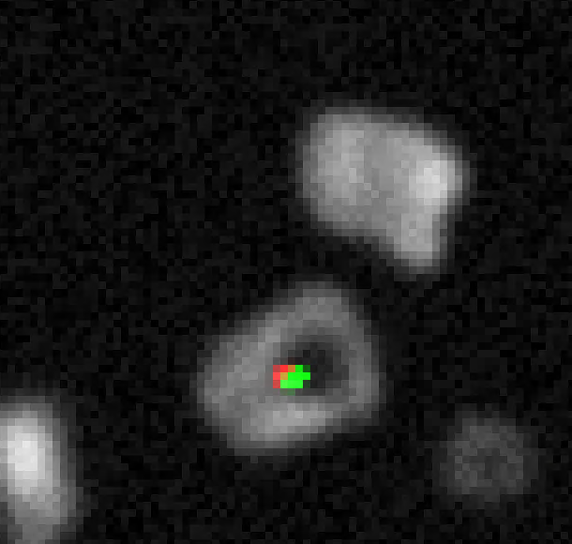
Supplementary slide

Slide 34
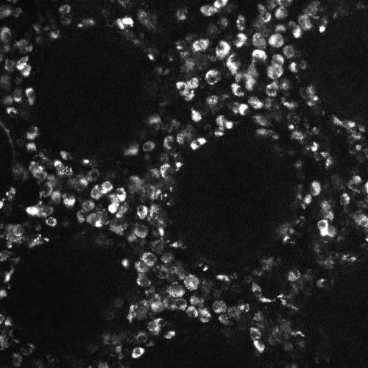
Supplementary slides
Comparison of high resolution and low resolution images
500x500 pixels
66x66 pixels

Slide 35


Supplementary slides
U-net and LinkNet architecture
U-net
LinkNet

